Slide 1
An introduction to transformers and SSM
Xiaolong Zou
2026.06.30

Slide 2
Outline
The Transformer Architecture
Structured State Space Models
Transformers, SSM and Neuroscience
Neuroscience-Inspired New Architectures

Slide 3
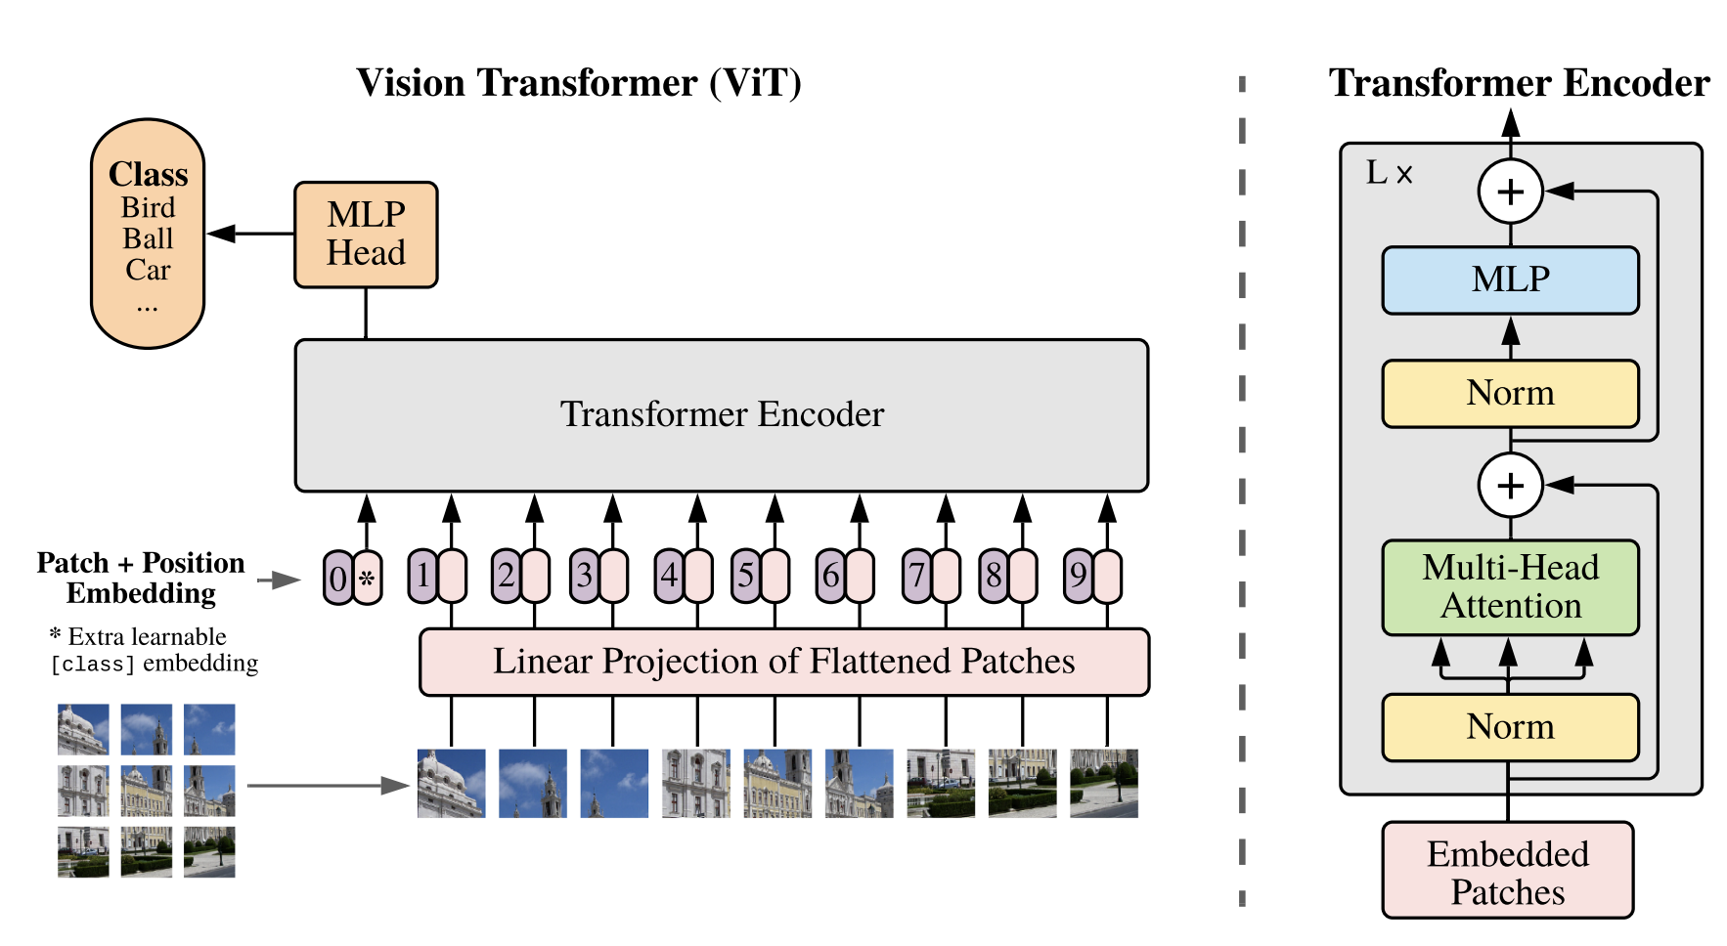
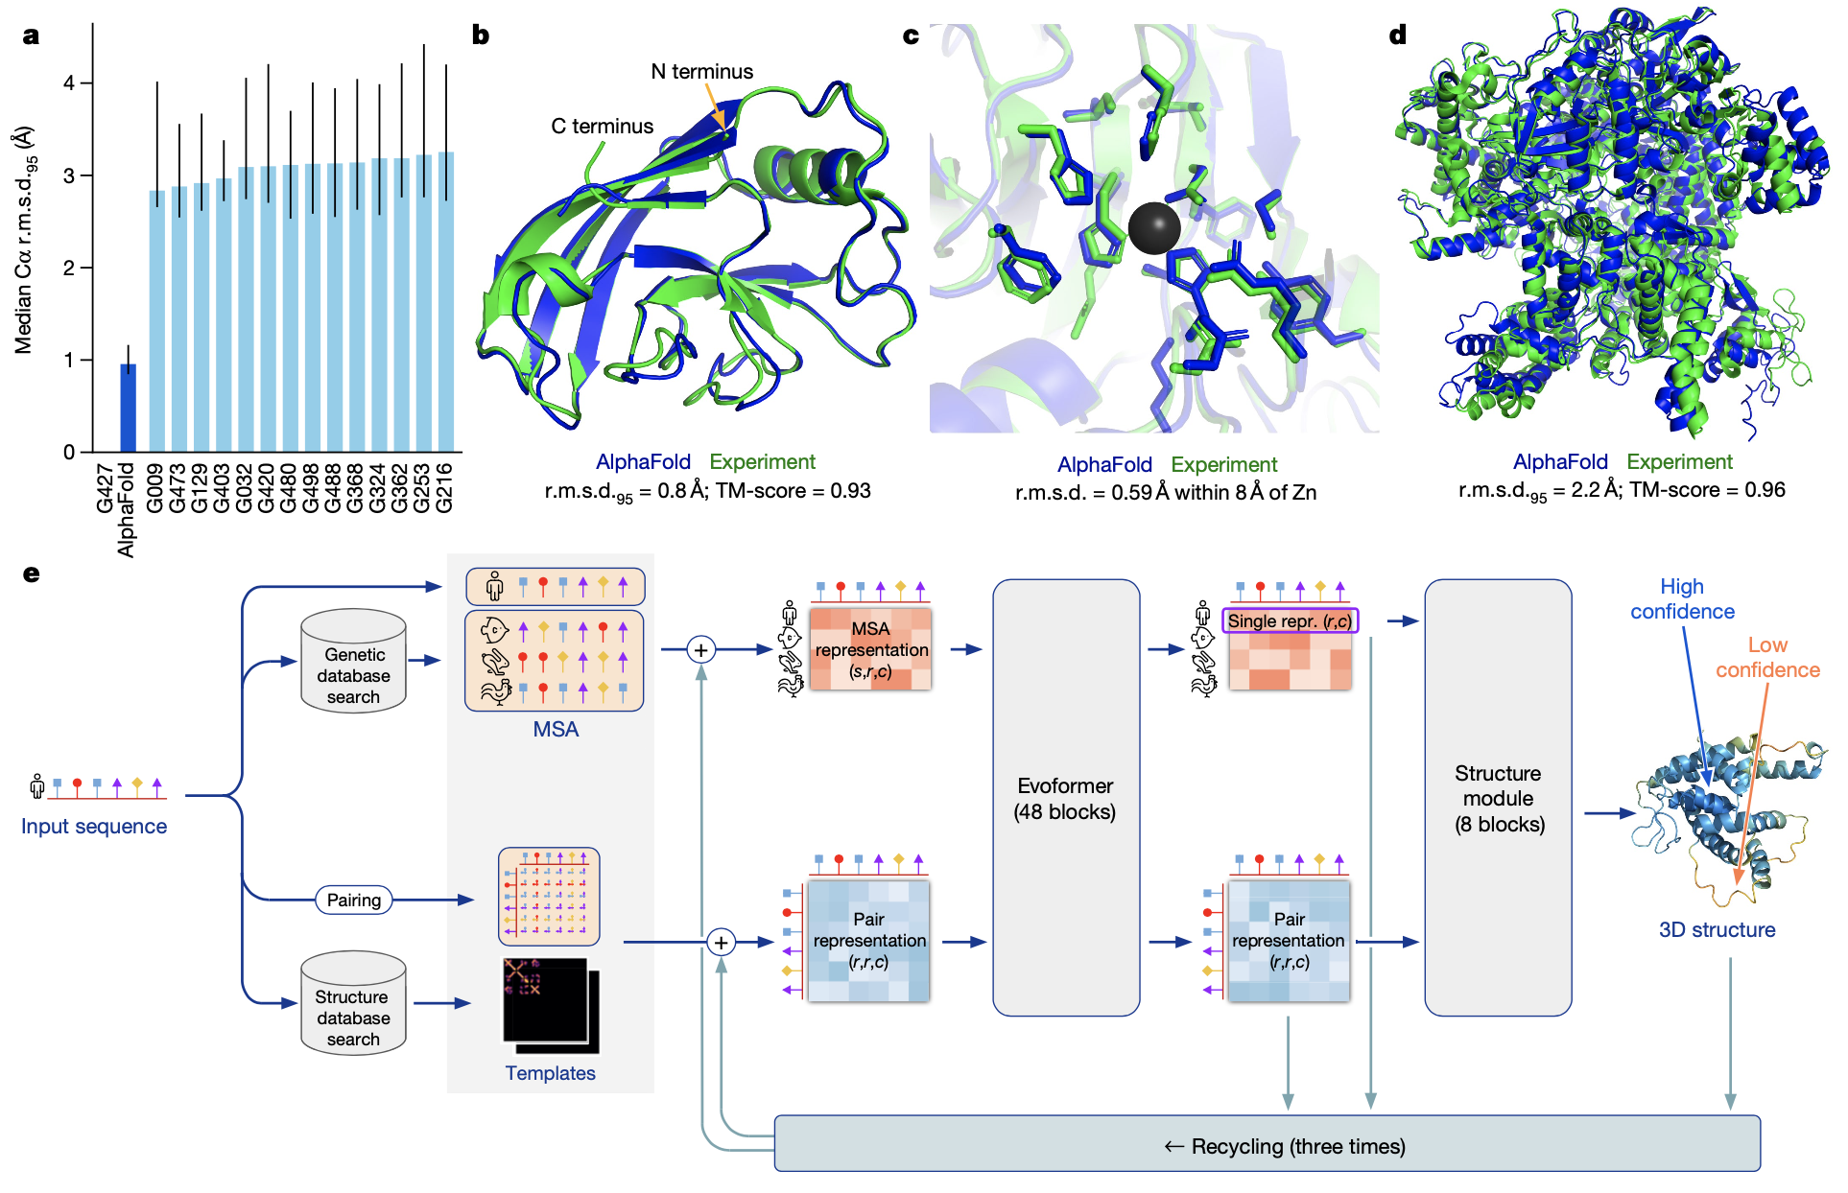
Natural language processing
Object recognition, detection, segmentation, generation..
Auto speech recognition
Alphafold

Slide 4
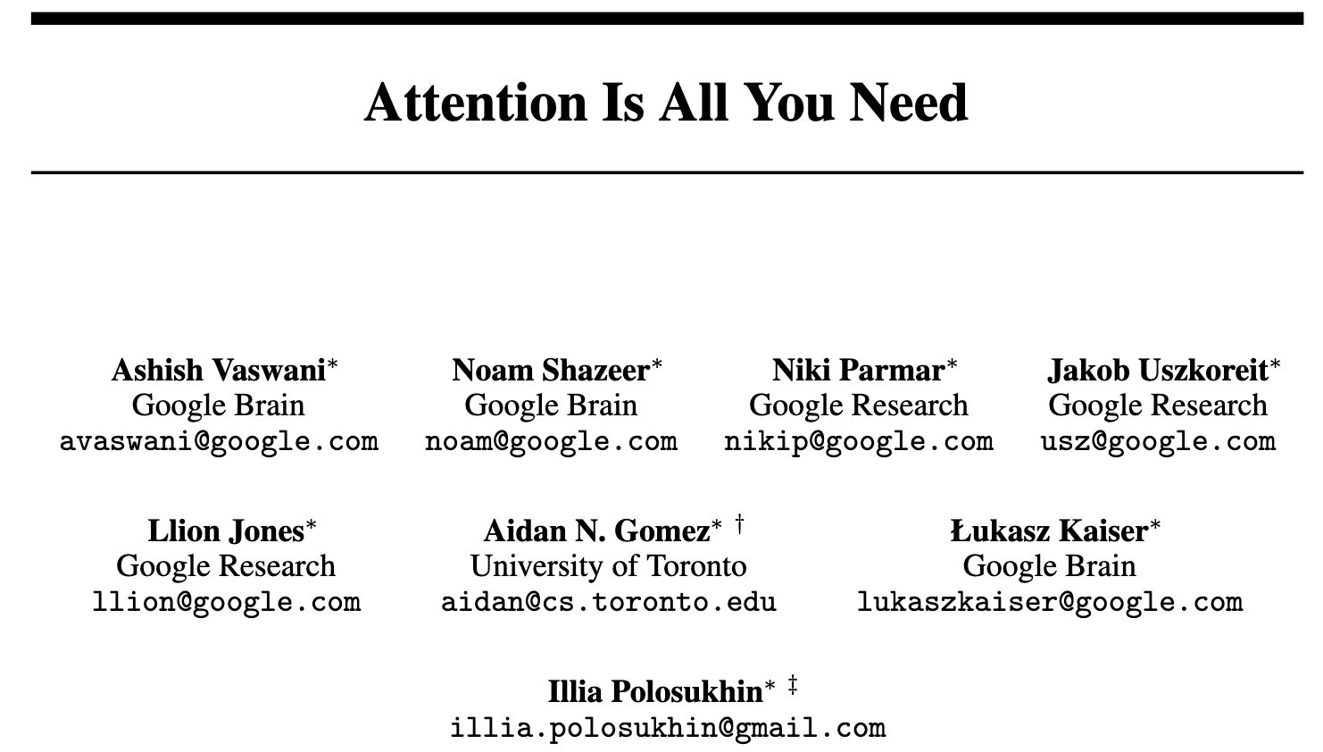
Transformer 架构奠定了当前以大语言模型为代表的生成式人工智能基础
1990s
“史前”时代
Rule-based methods, parsing, RNNs, LSTMs
2014
简单的自主力机制
2017
Transformer 架构诞生
Attention is all you need
2018
Transformer在NLP的爆发
BERT, GPT-3
2018-2020
Transformer在其它领域的爆发
ViTs, Alphafold-2.
2021-2022
生成式模型时代开启
Codex, Decision Transformers, GPT-X, DALL·E
2024
当前
NeurIPS, 2017
Chat-GPT, GPT-4, Gemini, Llama and open-source LLMs, Whisper, Robotics Transformer, Stable Diffusion, Sora …!

Slide 5
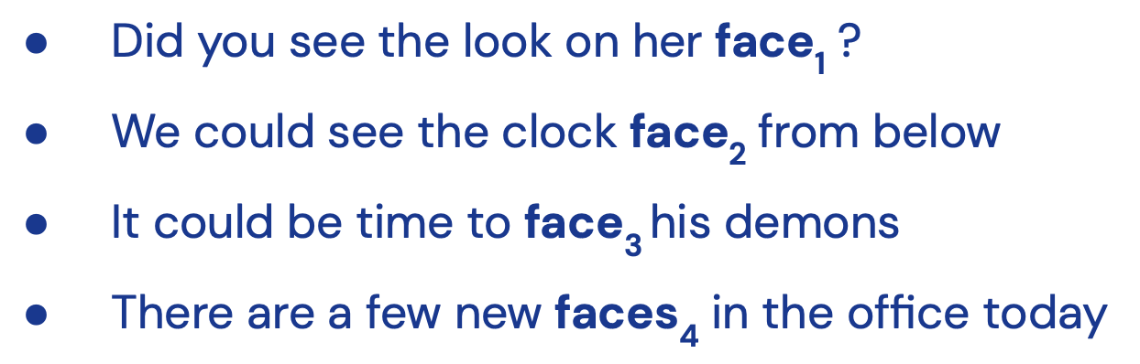

Some things about language
Words are not discrete symbols
Disambiguation depends on context
Important interactions can be non-local
The man who ate the pepper sneezed

Slide 6
Word2vector
One-hot vector representation
Distributed vector representation
If two words always appear together, then two word
embeddings should be similar (cosine similairty).
Orgthogonal, dimension same as the number of words

Slide 7
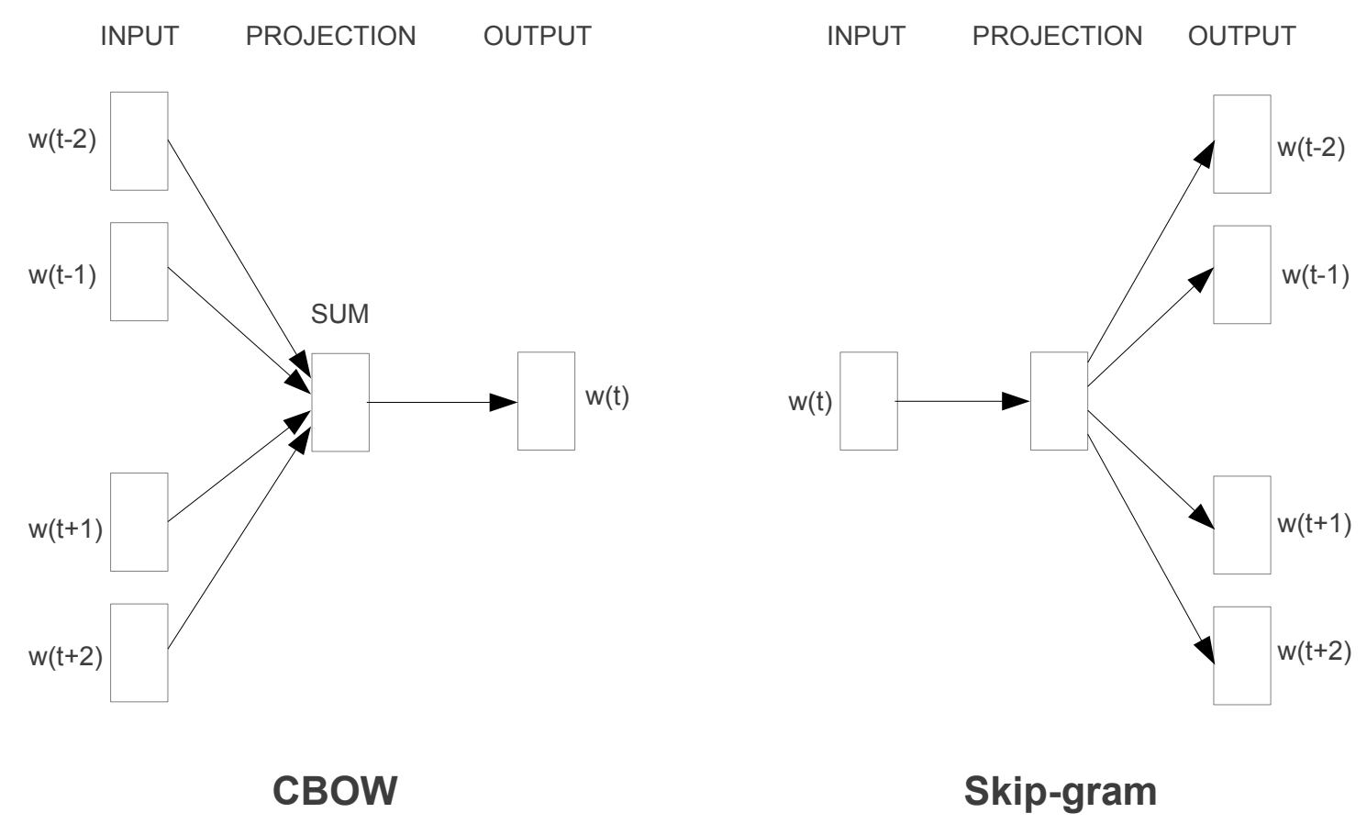
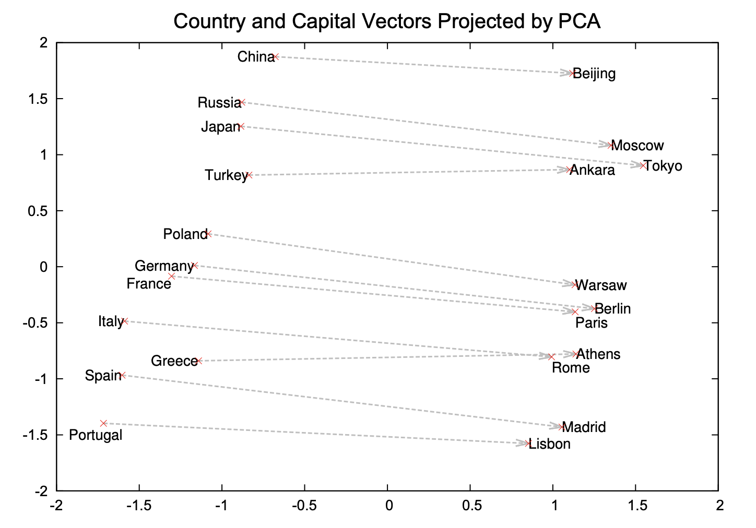
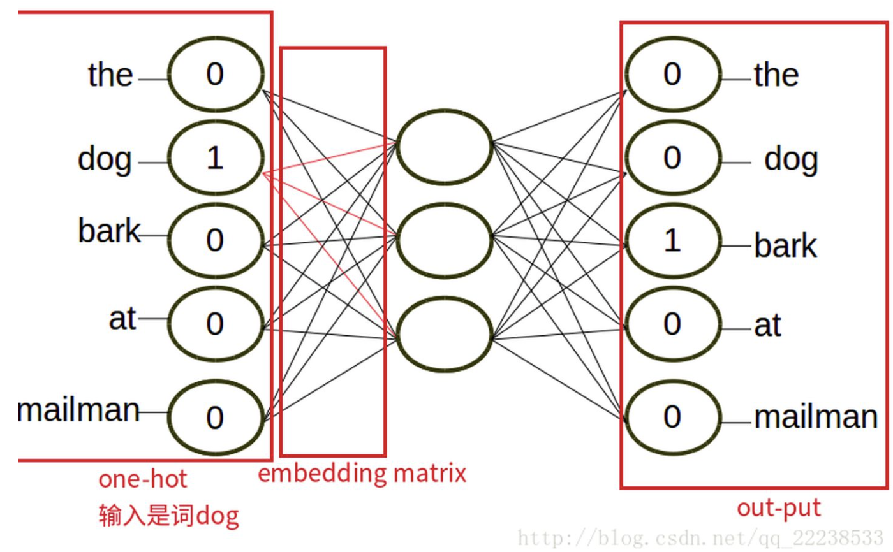
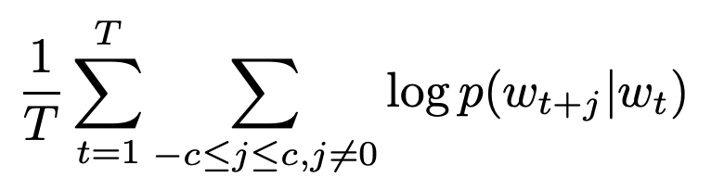
Word2vector
Mikolov T, Sutskever I, Chen K, Corrado GS, Dean J. Distributed representations of words and phrases and their compositionality. Neurips, 2013.
Notes:
Continuous bag of words

Slide 8
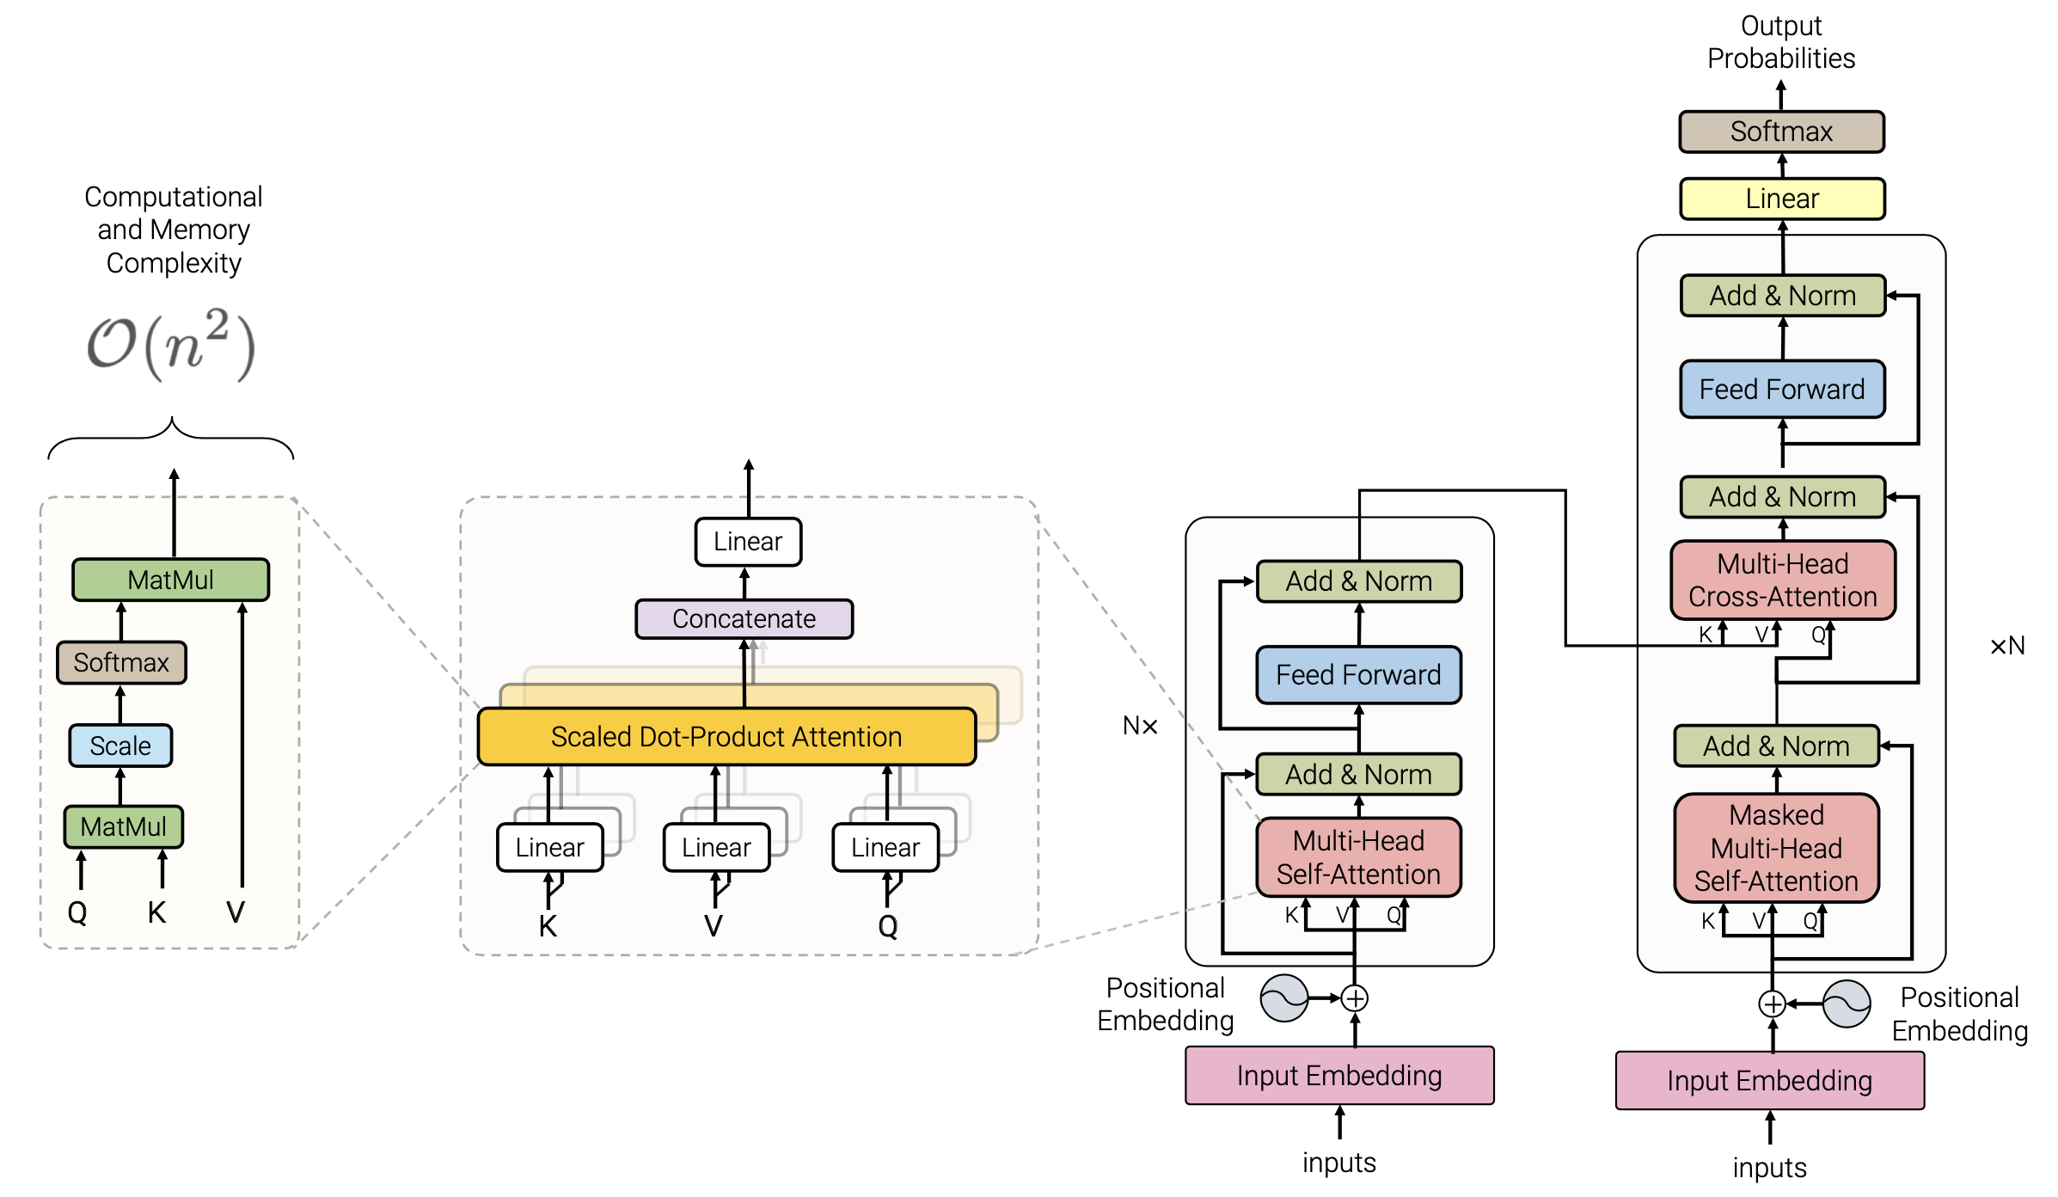
Transformers

Slide 9
Then transformer: words are represented by input embeddings
I like Trees

Slide 10




Self-attention over word input embeddings
$$q=mW_{q}; k={mW}_{k}; v={mW}_{v}$$
$$q$$
$$k$$
$$v$$
$$m$$
I like Trees

Slide 11


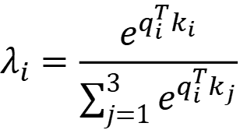





Self-attention over word input embeddings
$$λ_{i}=\frac{e^{q_{i}^{T}k_{i}}}{\sum_{j=1}^{3}{e^{q_{i}^{T}k_{j}}}}$$
$$λ_{1}$$
$$λ_{2}$$
$$λ_{3}$$
$$q$$
$$k$$
$$v$$
$$m$$
I like Trees

Slide 12
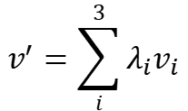
Self-attention over word input embeddings
$$v^{′}=\sum_{i}^{3}{λ_{i}v_{i}}$$
$$λ_{1}$$
$$λ_{2}$$
$$λ_{3}$$
$$q$$
$$k$$
$$v$$
$$m$$
I like Trees

Slide 13
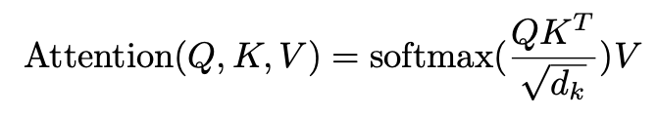

Compute self-attention for all word in input parallelly
$$Q, K are matrix d_{model}×d_{k};$$
$$V is a matrix d_{model}×d_{v}$$
$$q$$
$$k$$
$$v$$
$$m$$
I like Trees

Slide 14
Multi-head attention (H=4)
Self-attention in parallel
I like Trees

Slide 15
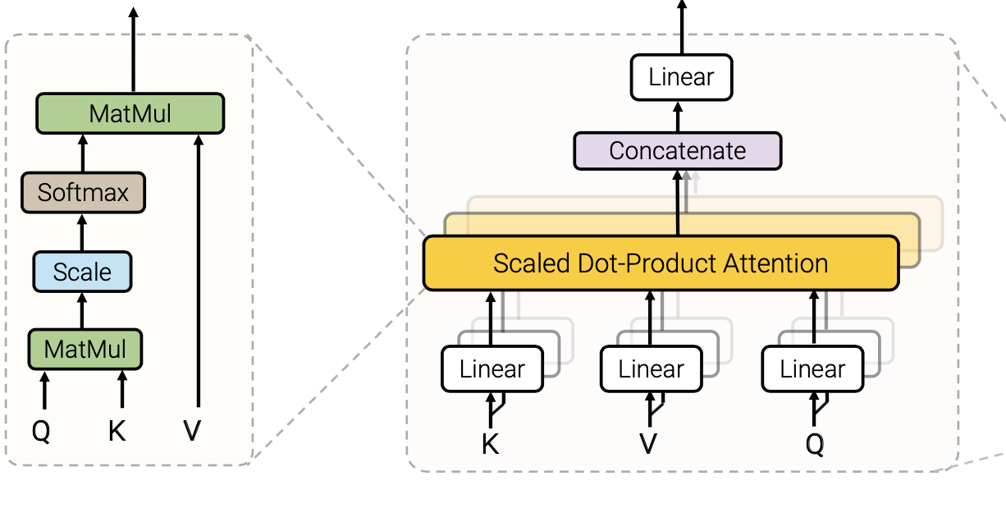
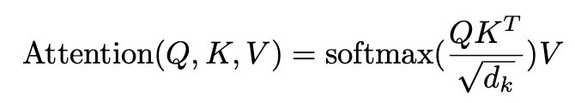
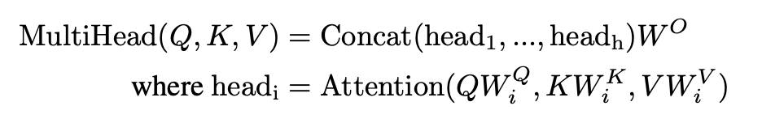
Transformers: multi-head attention
Ashish Vaswani et al, Attention Is All You Need , 2017, neurips

Slide 16
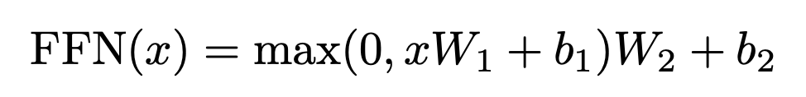



Transformers: feedforward layer
Position-wise feedforward layer
$$W_{2}$$
$$W_{2}$$
$$W_{2}$$
$$relu$$
$$W_{1}$$
$$W_{1}$$
$$W_{1}$$
After multi-head attention
I like Trees

Slide 17

A complete transformer block
Layer normalization
$$+$$
$$+$$
$$+$$
Skip connection
Feedforward layer
Position-wise feedforward layer
Layer normalization
$$+$$
$$+$$
$$+$$
Skip connection
Self-attention
I like Trees

Slide 18
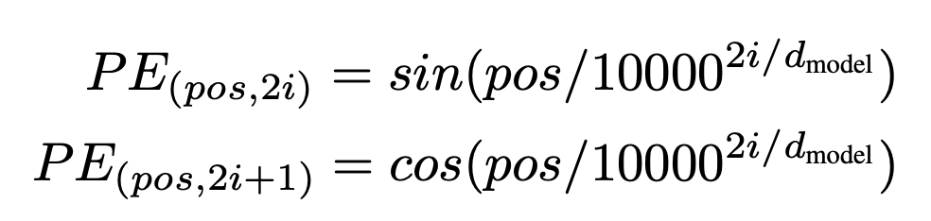

Transformer: Position encoding of words
Position vectors: make use of the order of the sequence
The positional encodings have the same dimension as the embeddings
The relative or absolute position of the sequence
Position vectors
$$+$$
$$+$$
$$+$$
Word embeddings
$$m$$
I like Trees
Notes:
1. We chose the sinusoidal version because it may allow the model to extrapolate to sequence lengths longer than the ones encountered during training

Slide 19
Transformer: Position encoding of words

Slide 20
Transformers

Slide 21
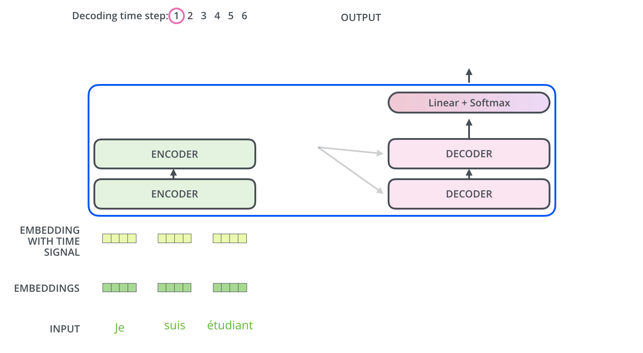
Transformers training on language task
From blog: http://jalammar.github.io/illustrated-transformer/

Slide 22
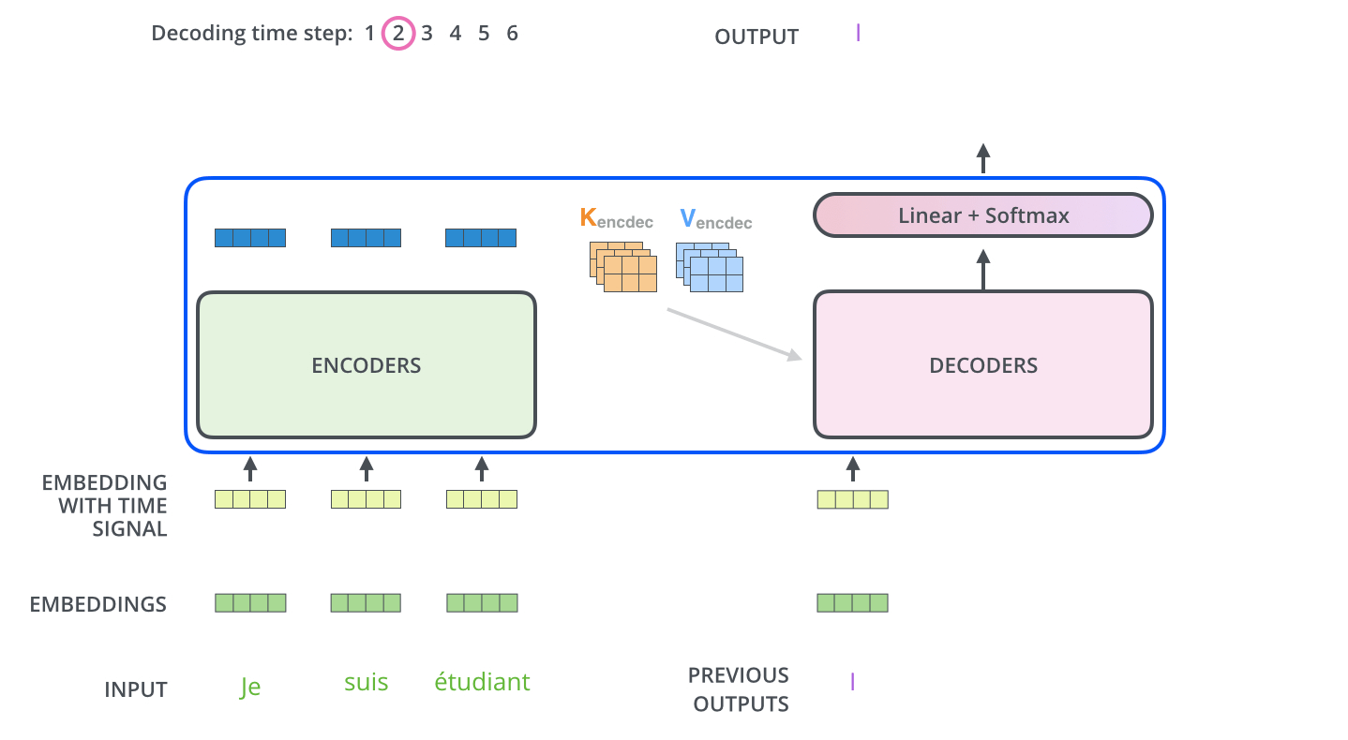
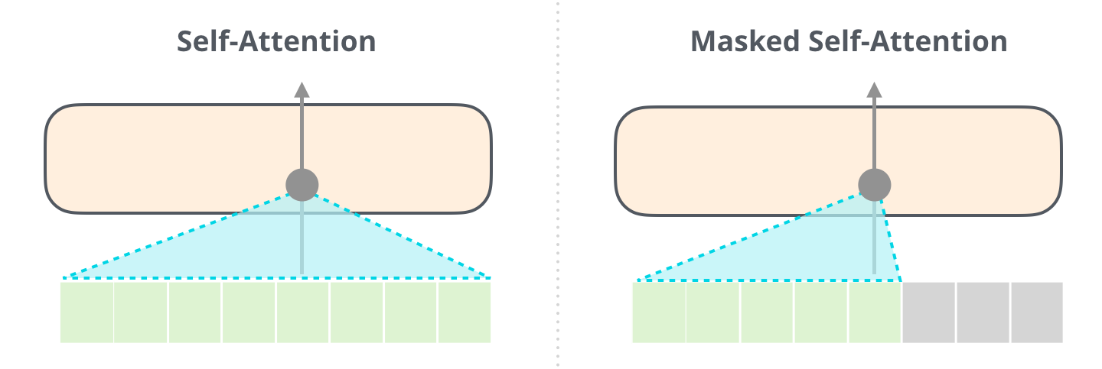
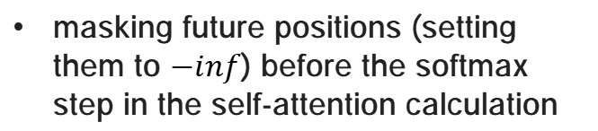
Transformers training on language task
masking future positions (setting them to $−inf$) before the softmax step in the self-attention calculation

Slide 23
Transformers training on language task

Slide 24
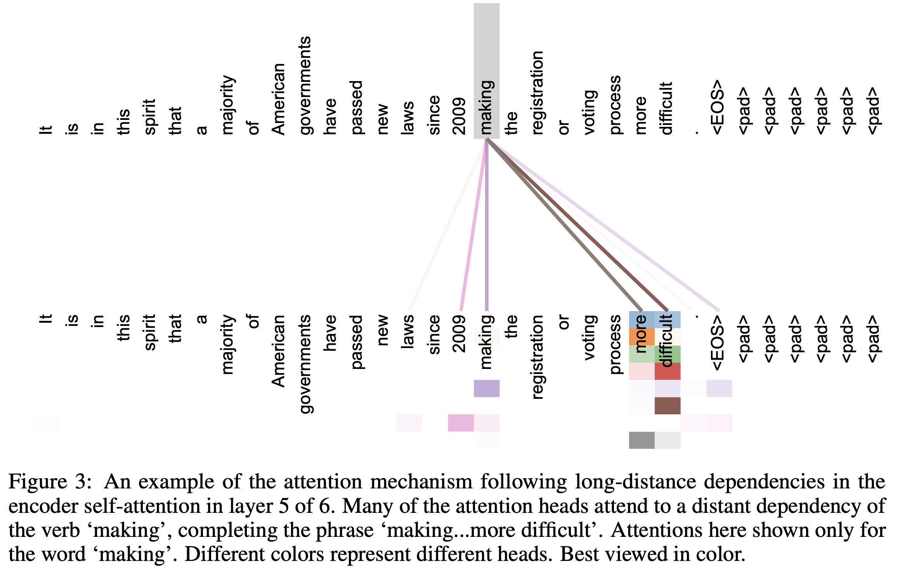
Attention visualization
37000 tokens

Slide 25
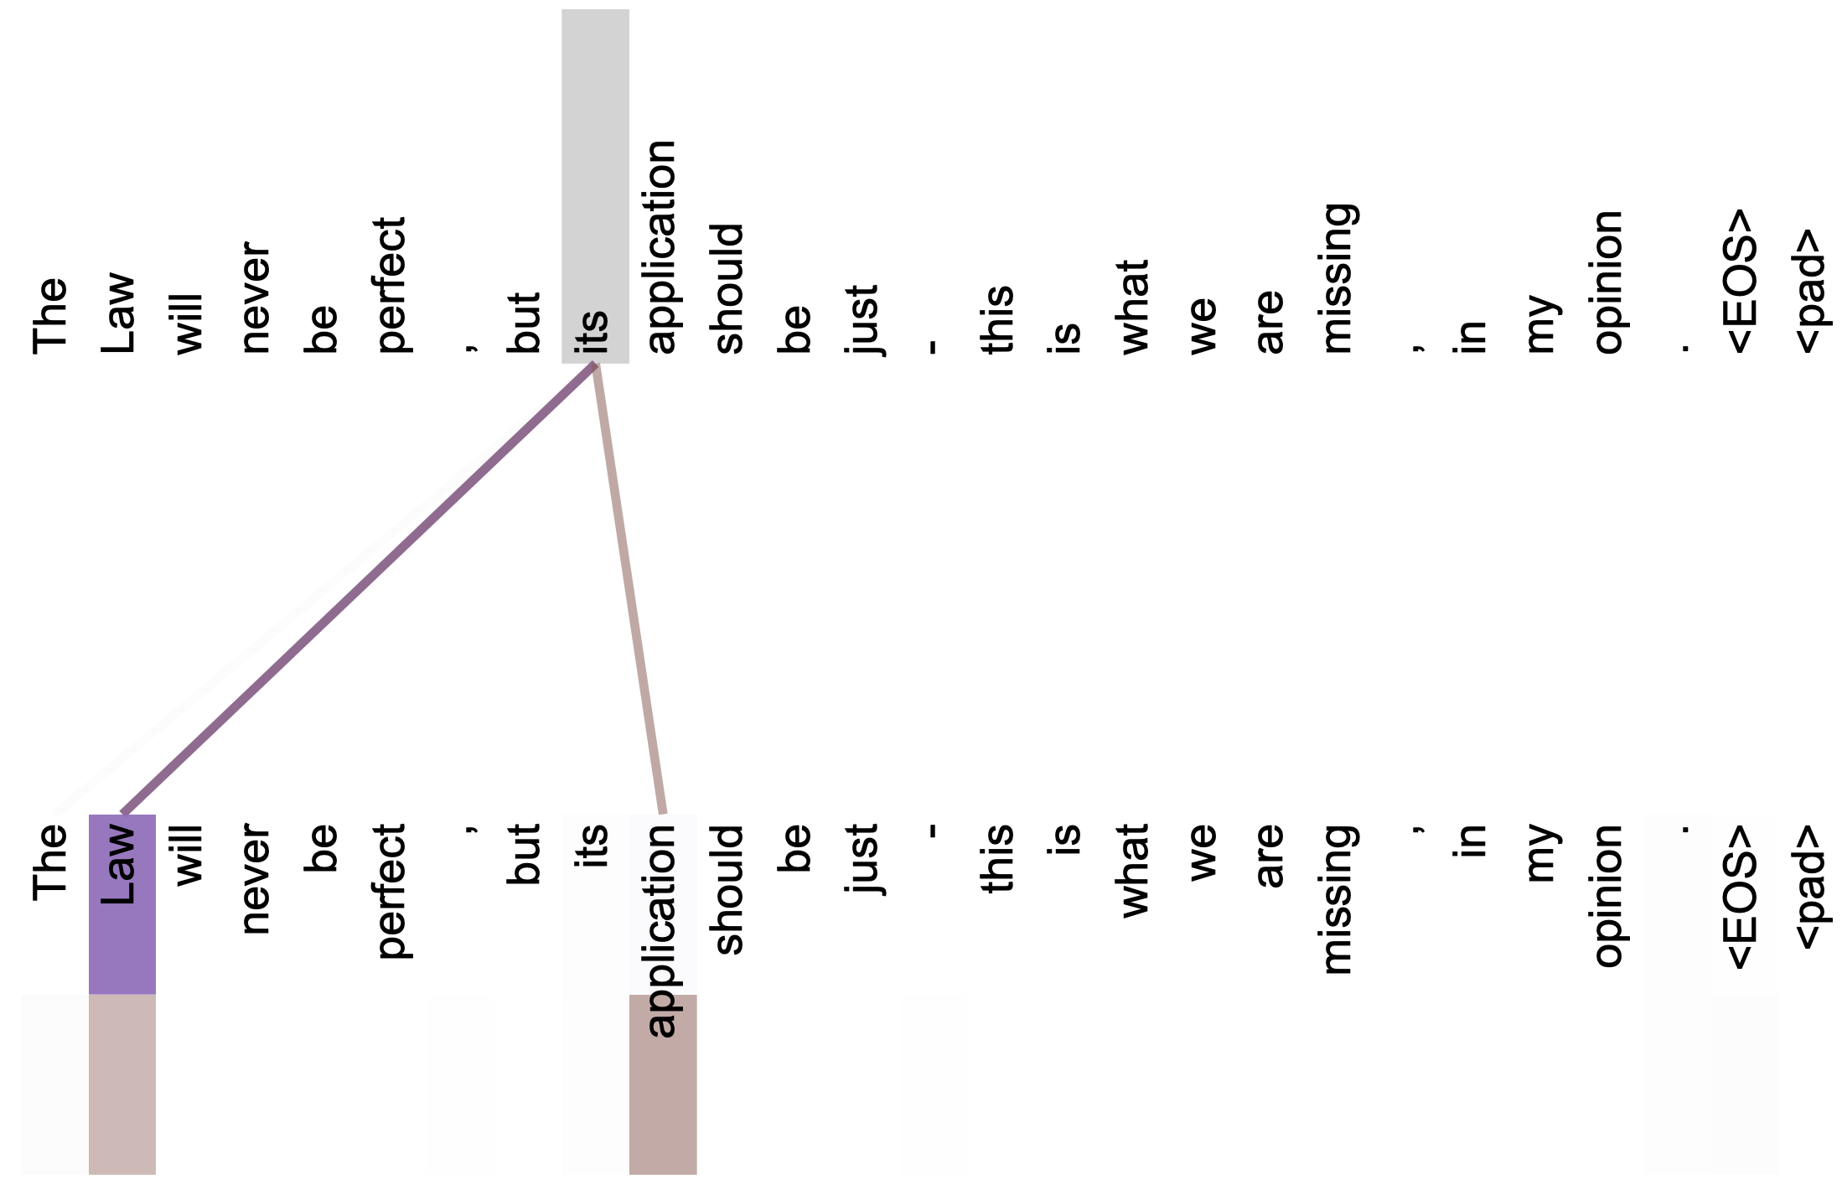
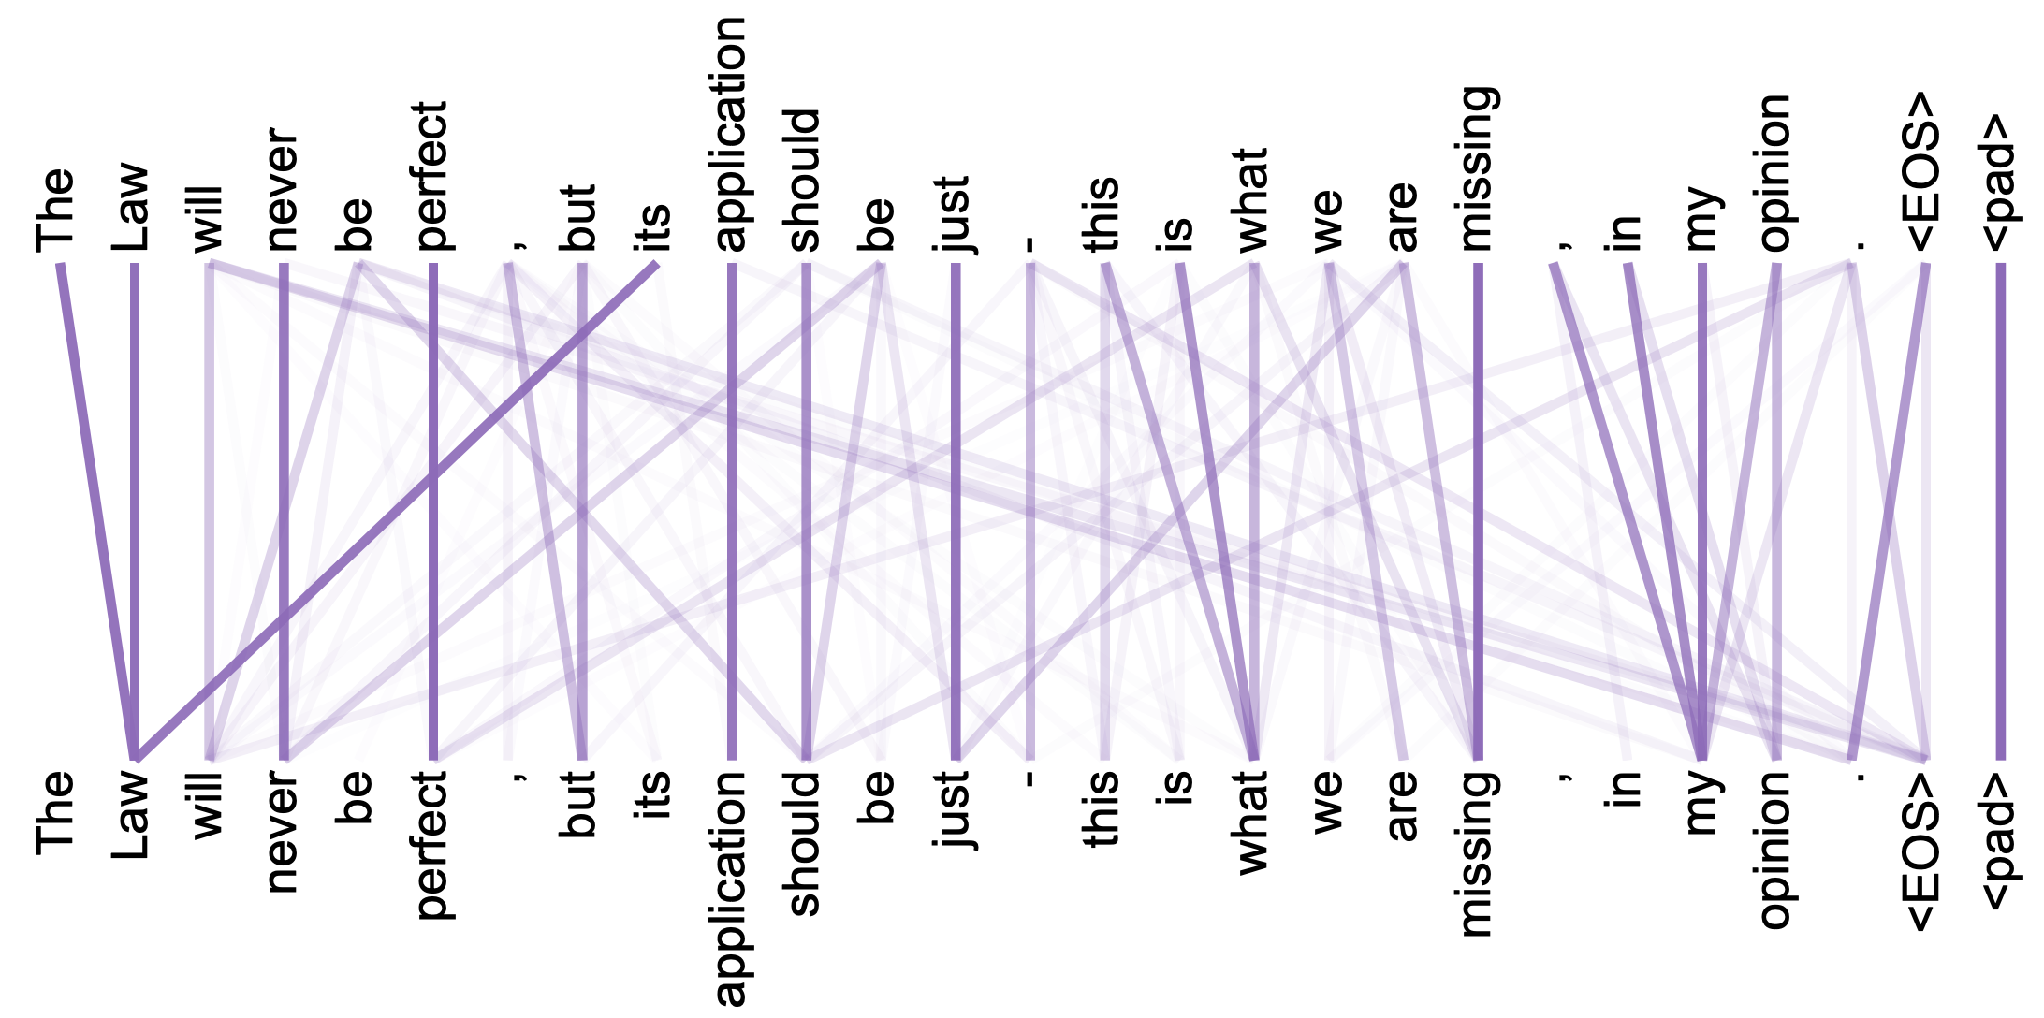
Attention Visualization

Slide 26
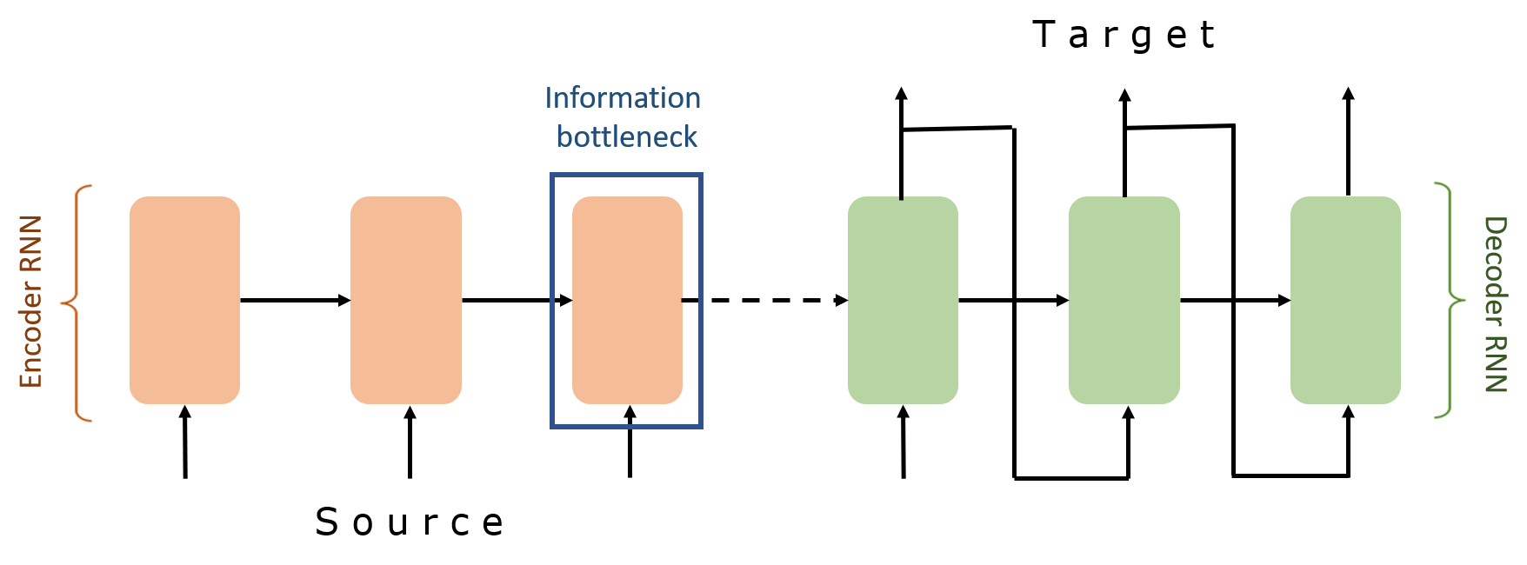
Transformer VS RNN
Learning long-term dependencies.
RNN:
Advantages
• Possibility of processing input of any length
• Model size not increasing with size of input
• Computation takes into account historical information
• Weights are shared across time
Drawbacks
• Computation being slow
• Difficulty of accessing information from a long time ago
• Cannot consider any future input for the current state

Slide 27
Language models, such Bert, GPT-3

Slide 28
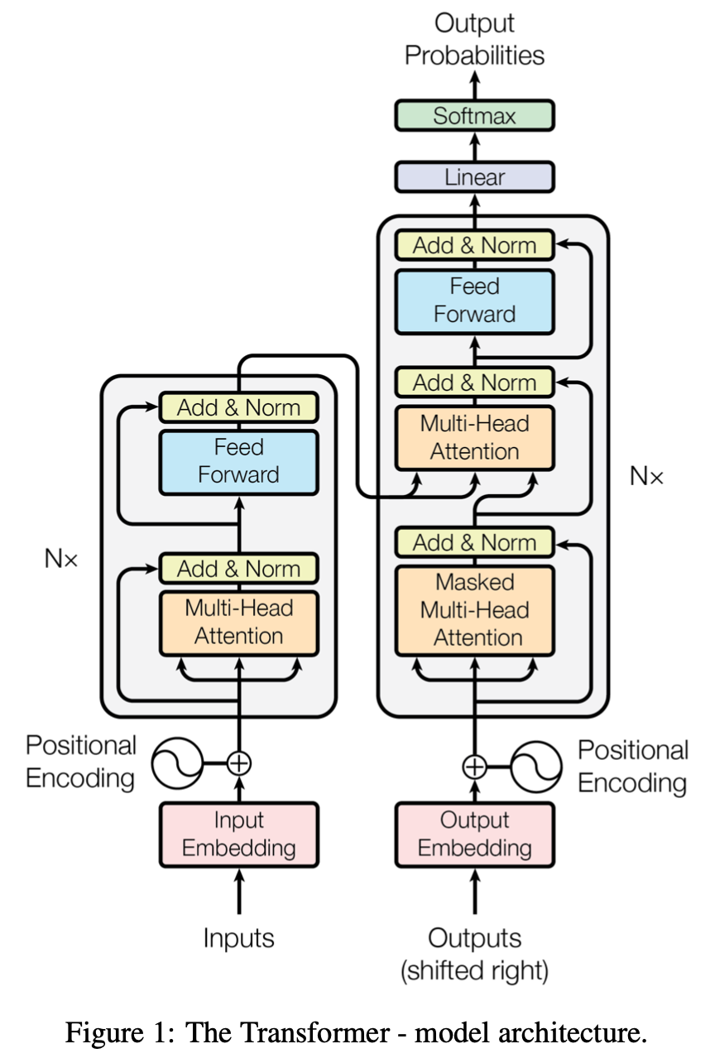
Transformers, Bert and GPT
A transformer uses Encoder stack to model input, and uses Decoder stack to model output (using input information from encoder side).
If we are only interested in training a language model for the input for some other tasks, then we do not need the Decoder of the transformer, that gives us BERT.
But if we do not have input, we just want to model the “next word”, we can get rid of the Encoder side of a transformer and output “next word” one by one. This gives us GPT.

Slide 29
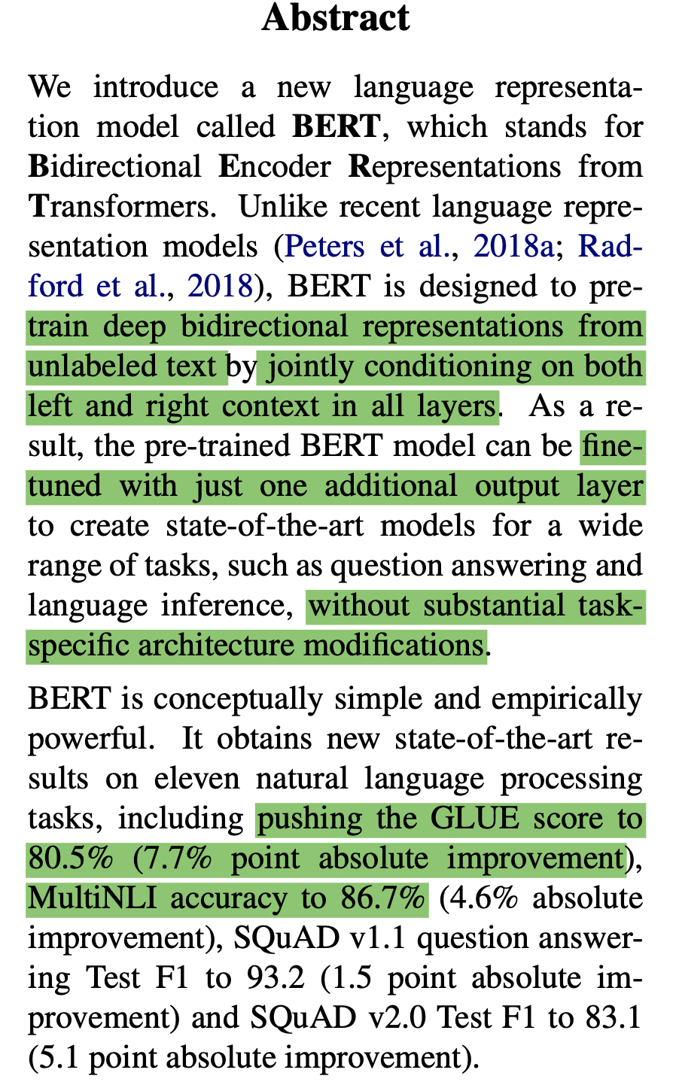
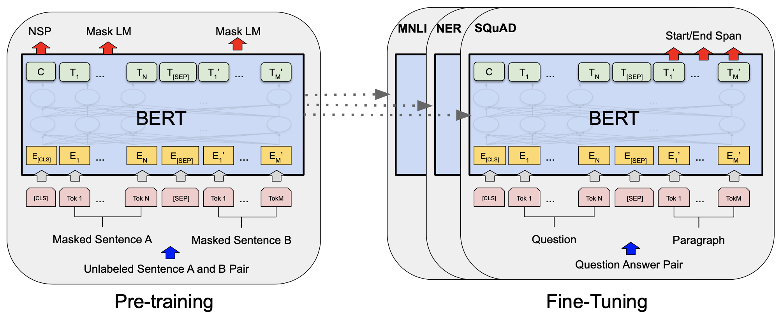
BERT: Bidirectional Encoder Representations from Transformers

Slide 30
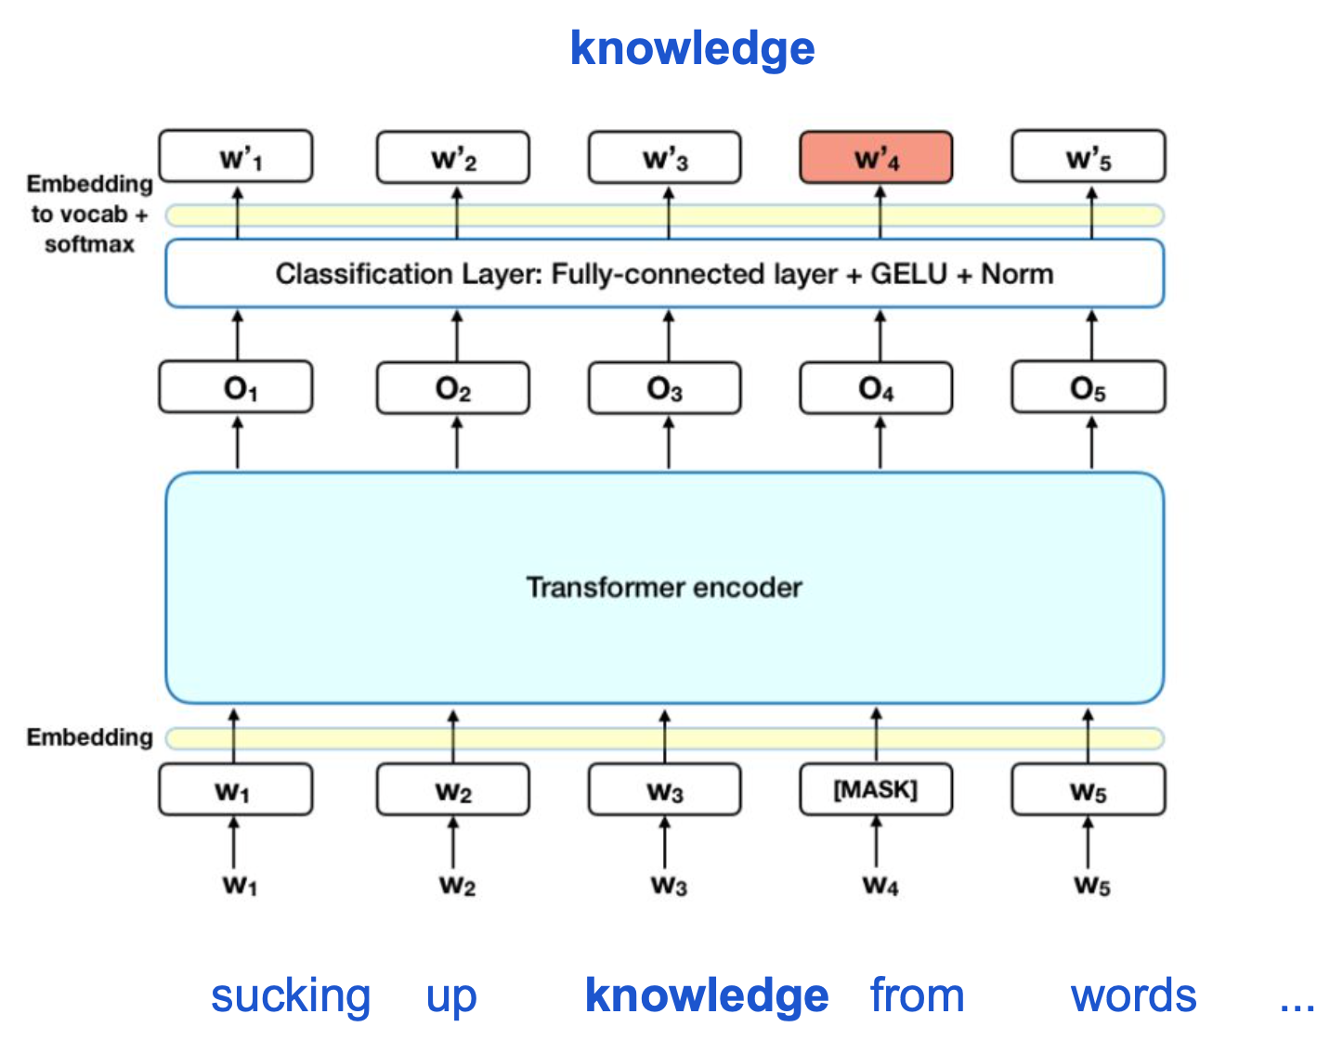
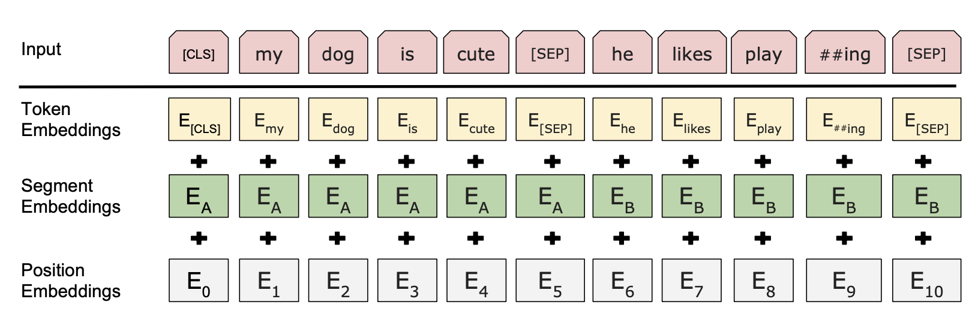
Masked language model pretraining

Slide 31
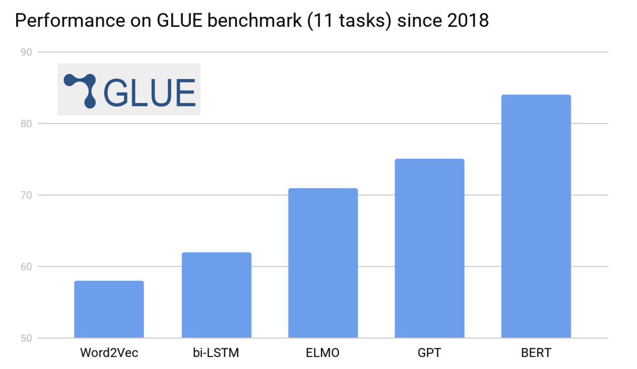
BERT supercharges transfer learning

Slide 32
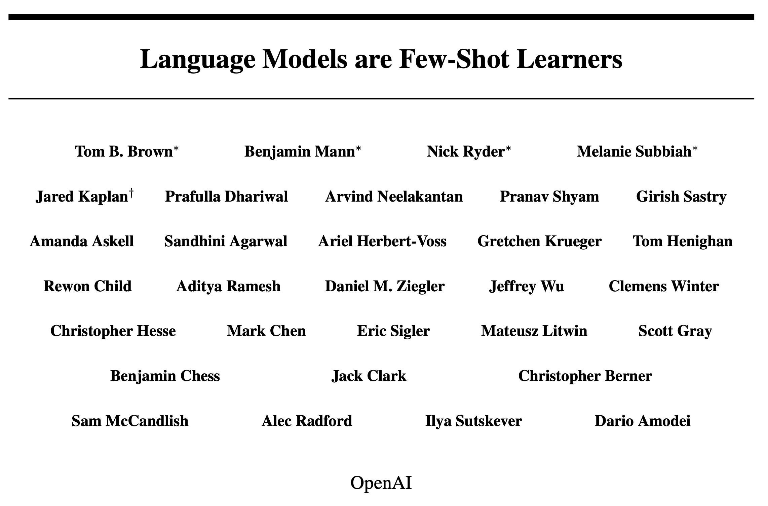
Neurips, 2020, best paper

Slide 33
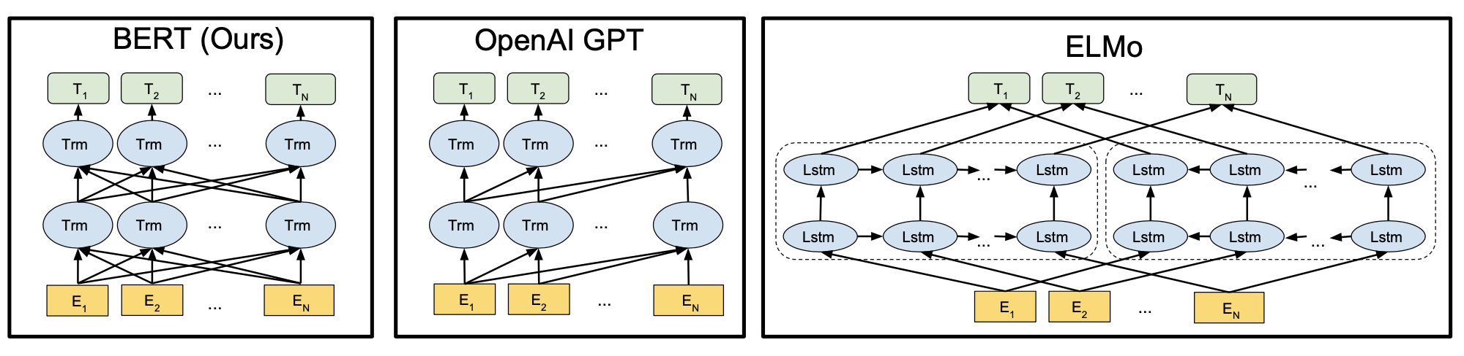
Different pre-training model architectures

Slide 34
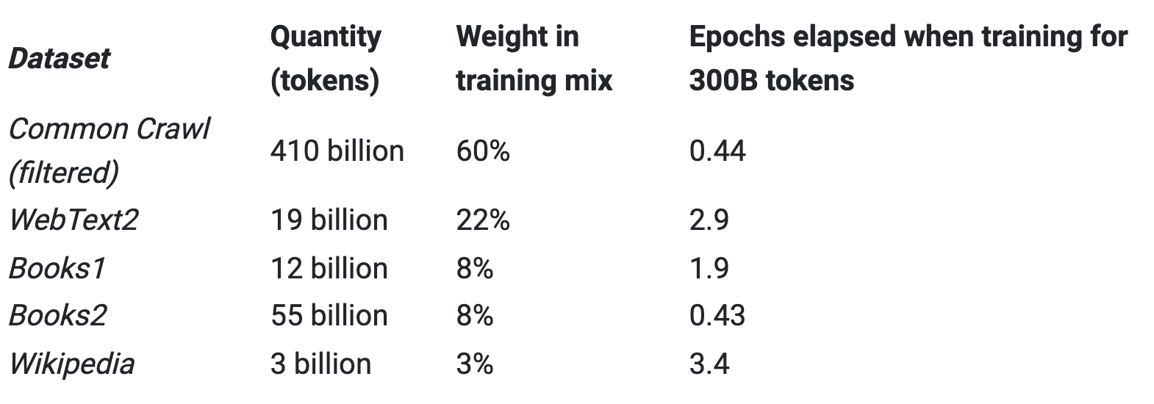
What makes GPT-3 different ?
GPT-3 is a very large language model (the largest till date) with about 175B parameters.
Constituting 45TB of compressed plaintext before filtering and 570GB after filtering, roughly equivalent to 400 billion byte-pair-encoded tokens
Notes:
Though the creators of GPT-3 took some measures to avoid the training and test data overlaps but a bug in the filtering caused some of the data to leak

Slide 35
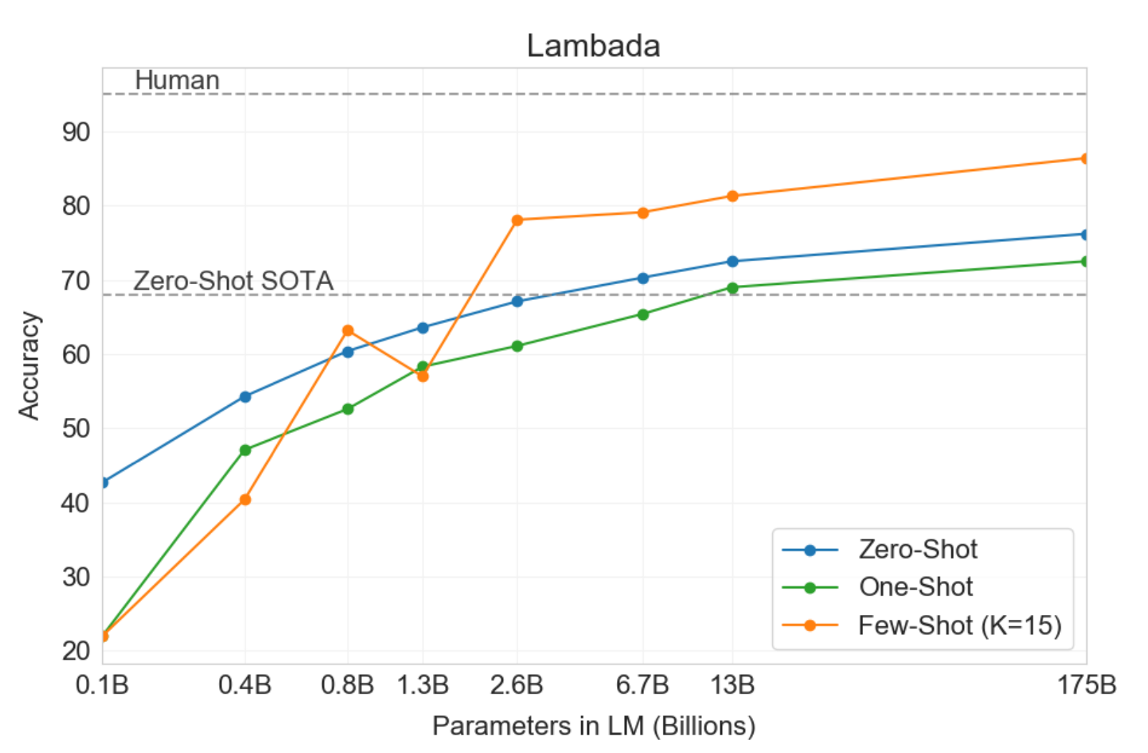
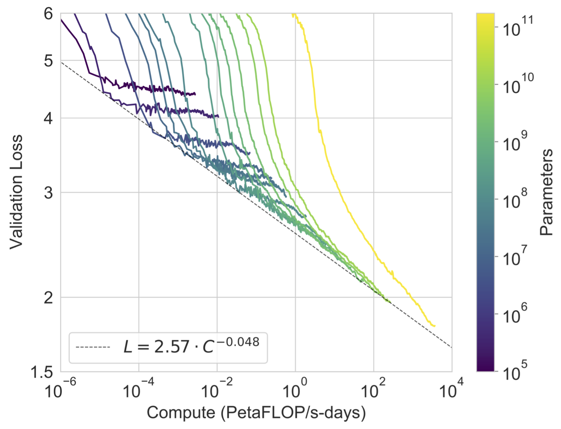

Slide 36
Structured State Space Models

Slide 37
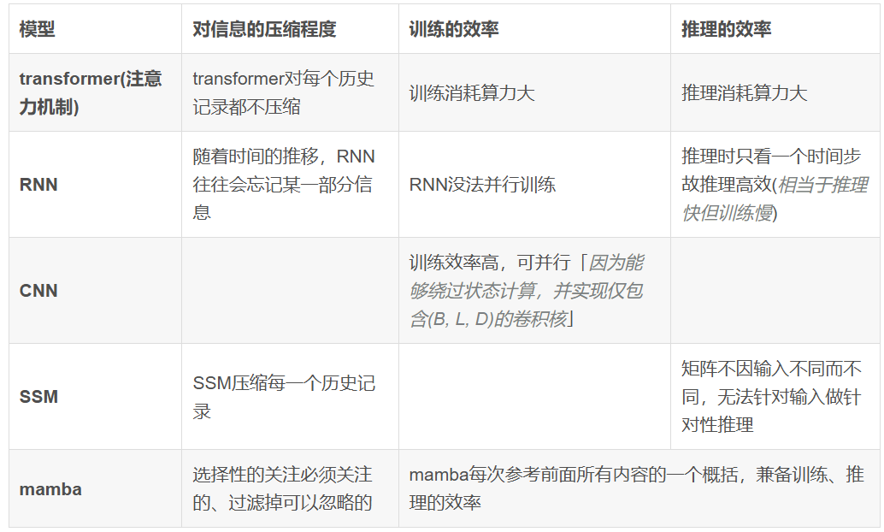
现有模型的对比：
为结构化状态空间模型引入了一种选择机制，使其能够执行与上下文相关的推理，同时按序列长度线性扩展。

Slide 38
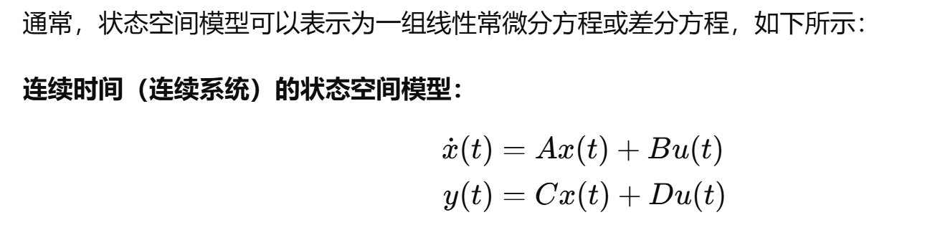
What is state space model ?
一种描述动态系统行为的数学模型（动力学系统）
如RNN，LSTM，Hopfield model 等等

Slide 39
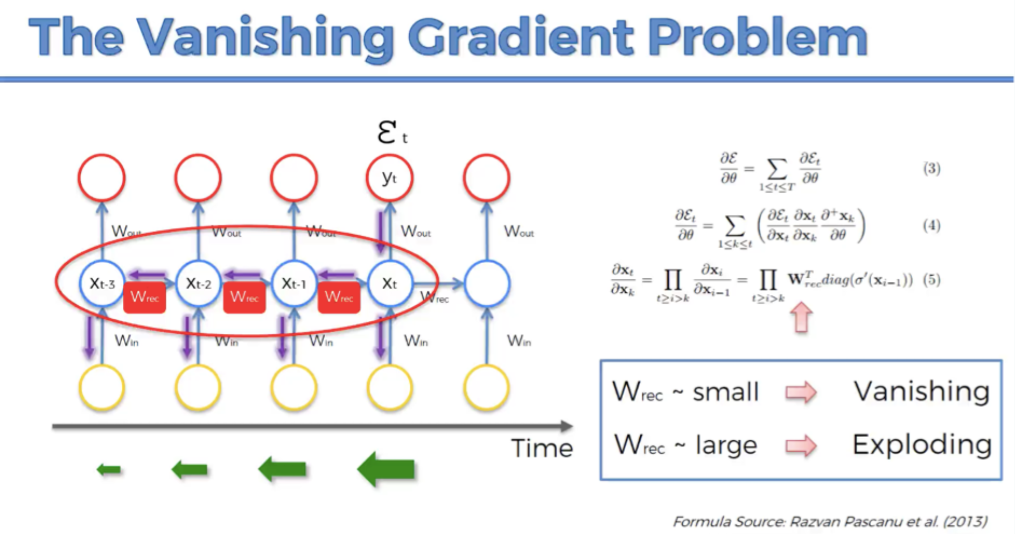
后果：难以基于梯度学习算法，学习长序列之间的依赖关系

Slide 40
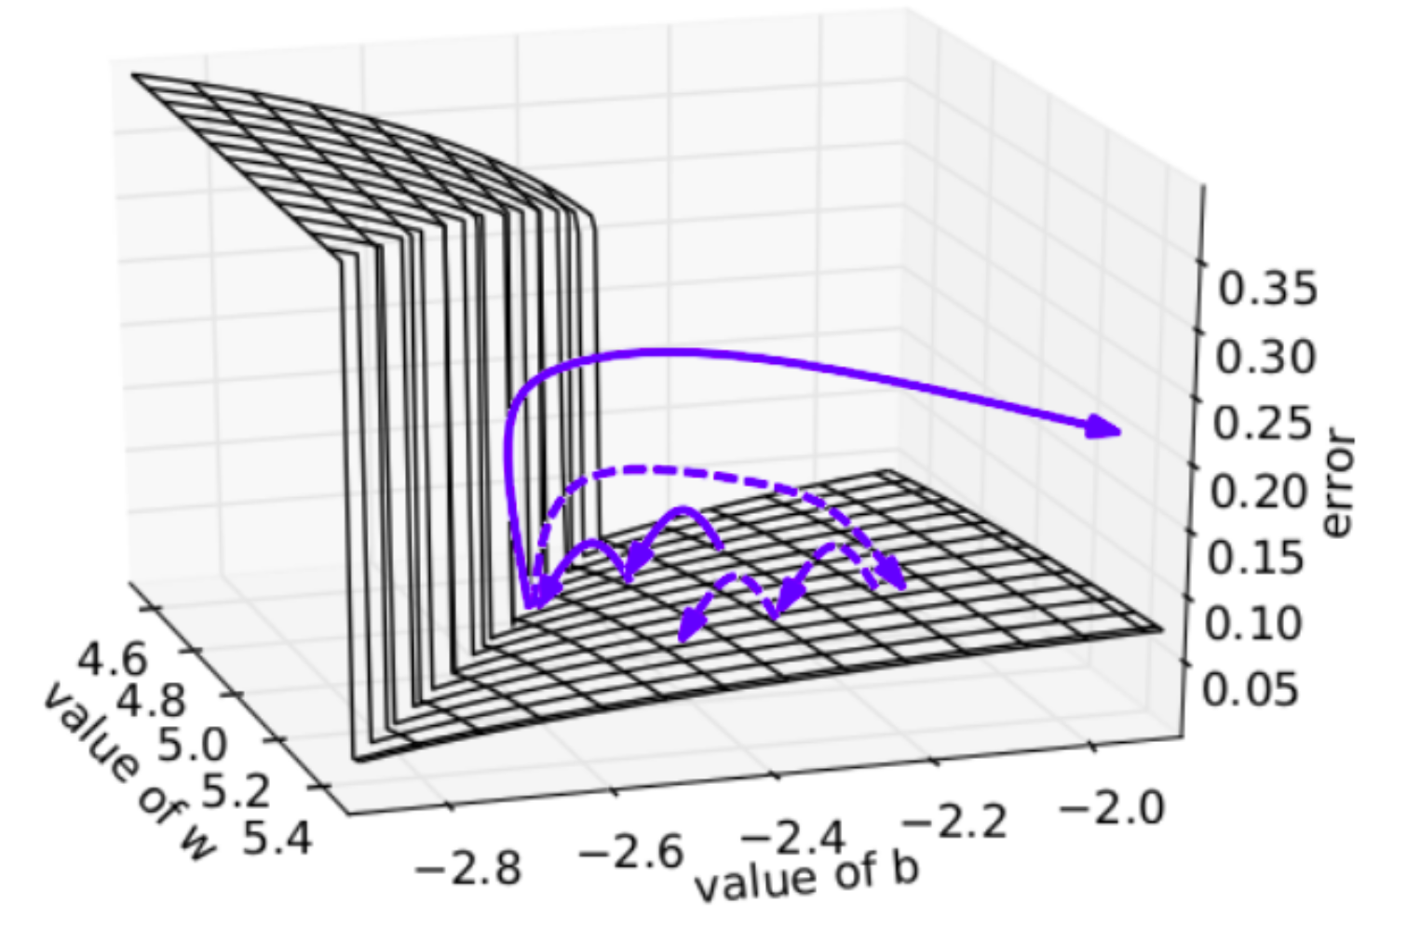
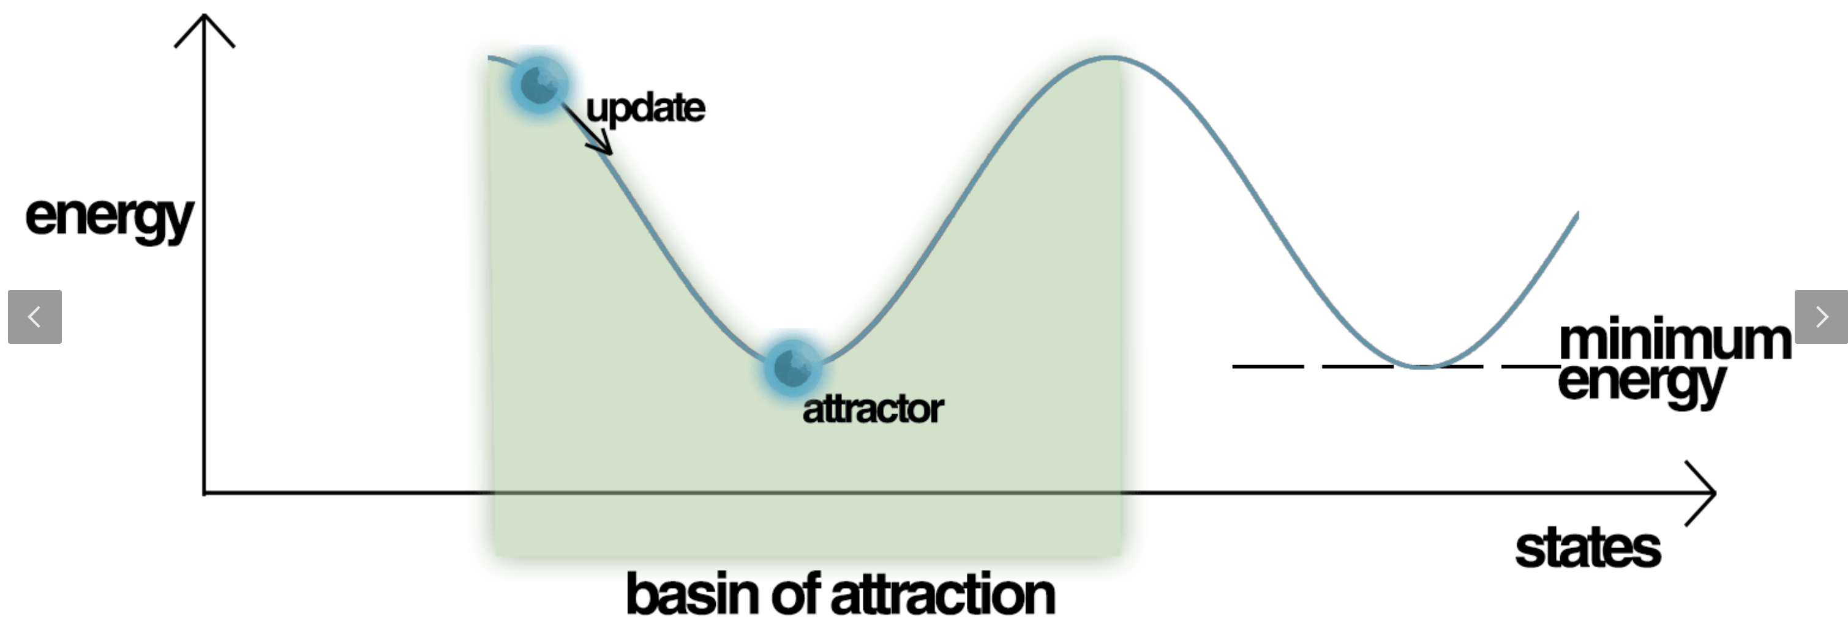
From a dynamical system view
Exploding gradient
Vanishing gradient

Slide 41
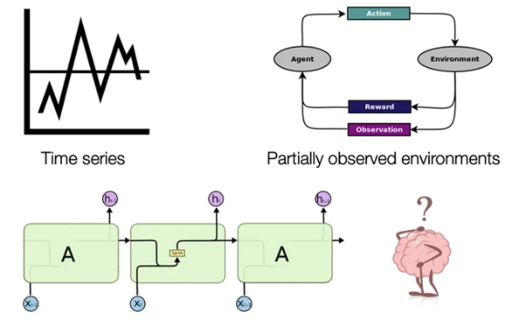
Memory representations for sequential data
Incrementally maintain a representation of the entire sequence history

Slide 42
Key idea of structured state space model
克服状态空间模型长时序建模的难题
将非线性的状态空间模型进行线性化，从而实现卷积运算等，实现高效的训练和推理

Slide 43
A good state space model
Memorizing sequences online
Handle long-term dependencies empirically
Address variable sampling rates and timescale distribution shift

Slide 44
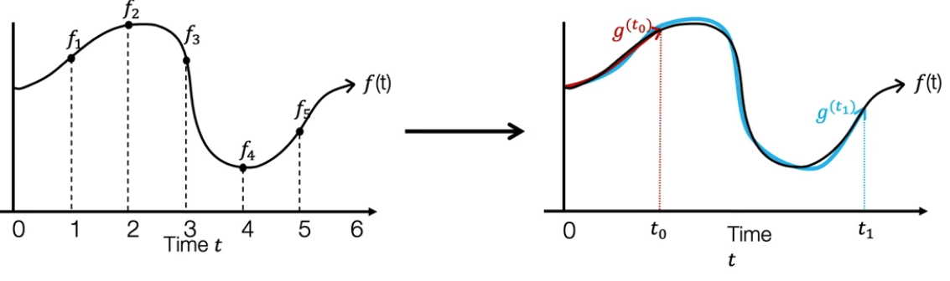
Online function approximation
RNN hidden state -> 实时地重构$f(t)$

Slide 45
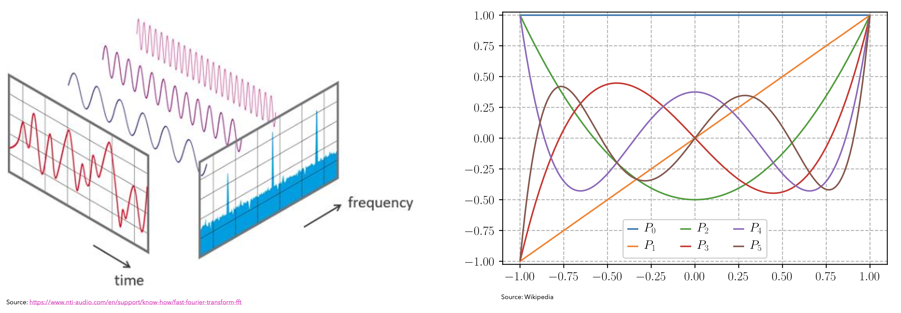
如果需要一个hidden state 最优地保存了一个sequence的信息：
可以将sequence 信息投影在一个定义好的泛函空间，hidden state 只需要保存空间中对应的坐标或者投影系数即可
Fourier transformation
Legendre polynomials

Slide 46
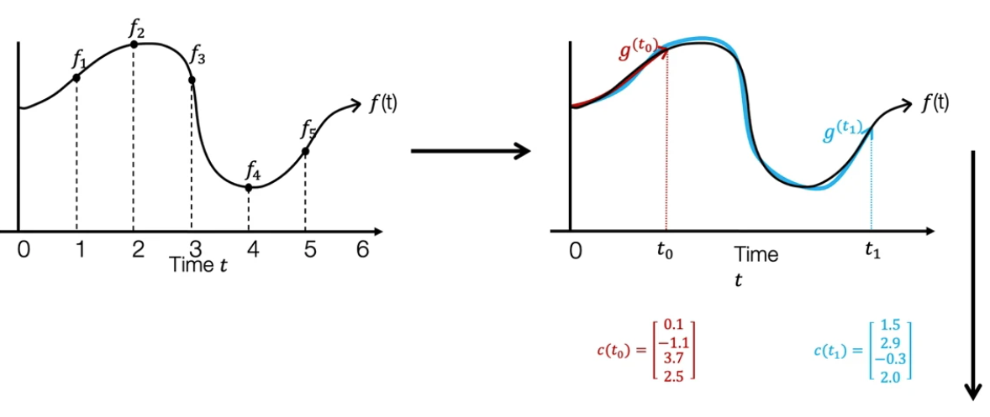

Online function approximation: 如何在线地获取投影系数？
如何实时地获取$c\left(t\right)?$

Slide 47
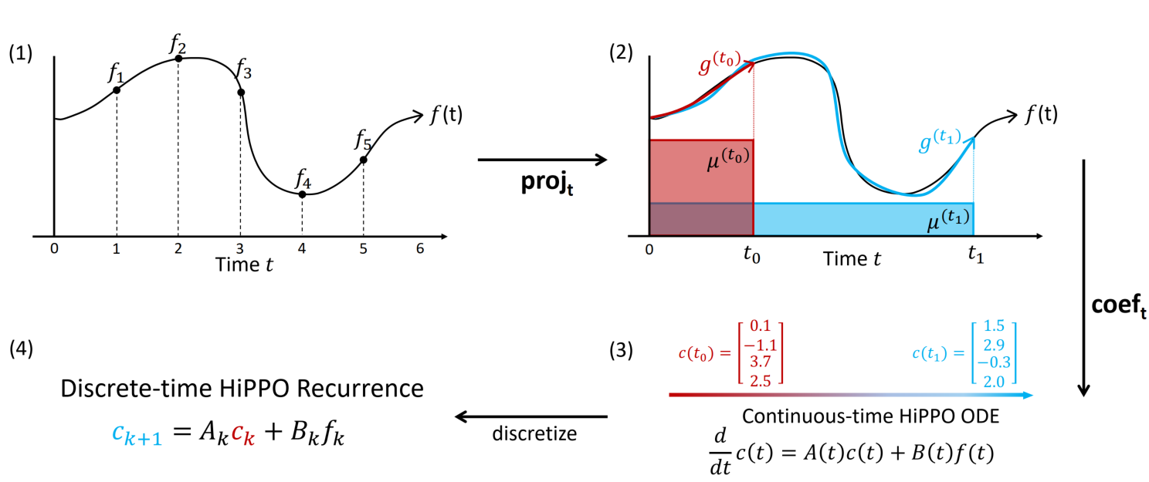
HiPPO framework: Memorizing sequences online

Slide 48
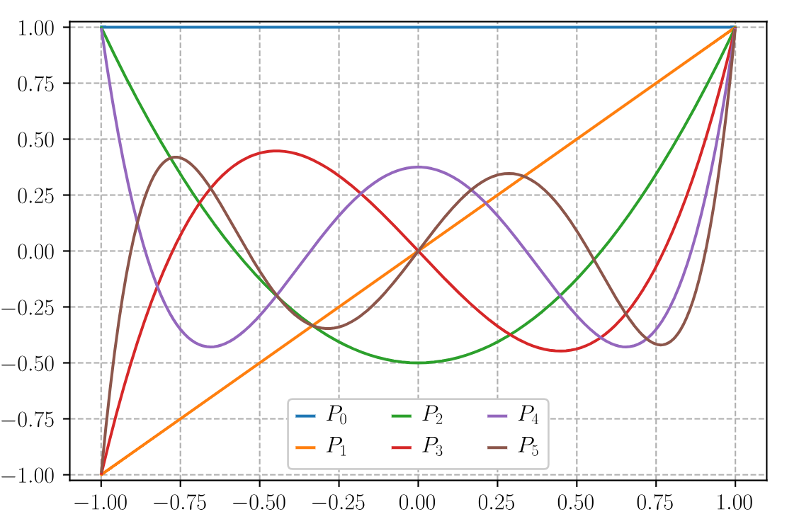
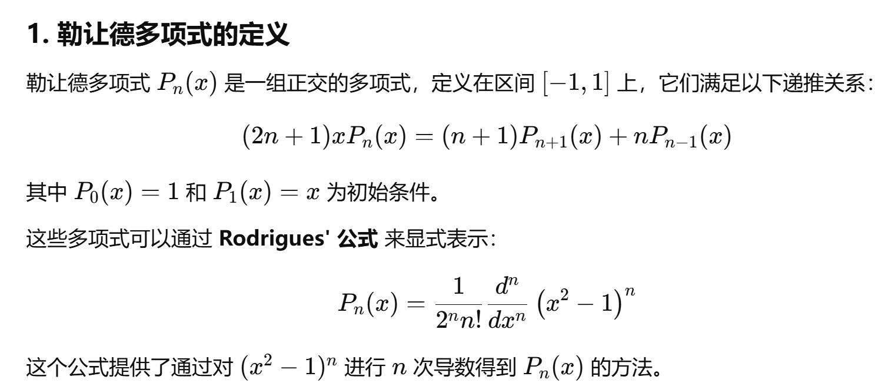
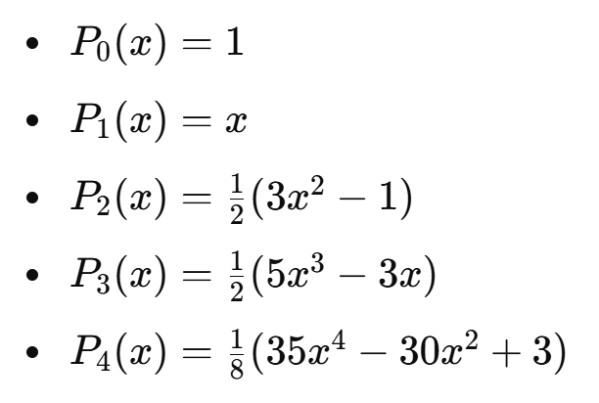
Legendre polynomials
关键性质：正交性

Slide 49
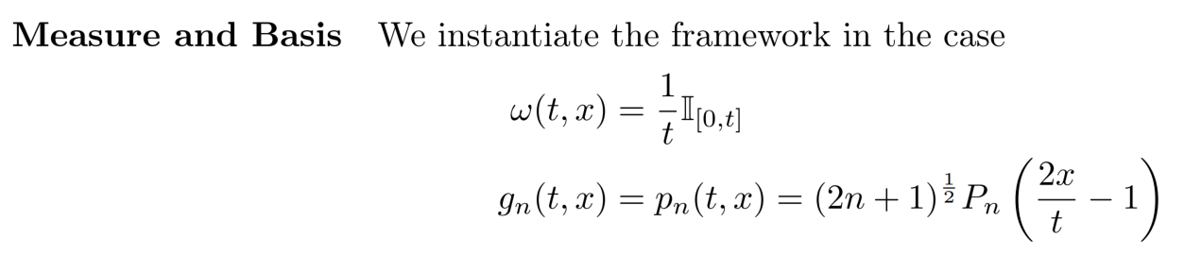

以HiPPO-LegS 为例

Slide 50


Slide 51

Online update version
Coefficient dynamics can be represented as a linear ODE,
optimal A and B can be solved!

Slide 52


HiPPO-LegS

Slide 53
HiPPO framework: Memorizing sequences online
如何对连续时间的ODE进行离散化 ？

Slide 54

State space model
A state space model allows us to map an input signal 𝑥(𝑡) to an output signal 𝑦(𝑡) by means of a state representation $h(t)$as follows:
$$h^{′}\left(t\right)=Ah\left(t\right)+Bx(t)$$
$$y\left(t\right)=Ch\left(t\right)+Dx\left(t\right)$$
The state space model is Linear and time-invariant
数值解法：
Euler
Bilinear
Closed-form solution

Slide 55


Closed-form solution
$h^{′}\left(t\right)=Ah\left(t\right)+Bx(t)$
A general closed form solution, $h\left(t\right)=−\frac{B}{A}+C_{0}e^{At}$
$h\left(t+Δ\right)=−\frac{B}{A}+C_{0}e^{At}e^{AΔ}=e^{ΔA}h\left(t\right)+A^{−1}\left(e^{ΔA}−I\right)Bx(t)$
Note: in practice, we do not choose the discretization step ∆, but we make it a parameter of the model so that it can be learnt with gradient descent.

Slide 56



离散化

Slide 57


Recurrent computation

Slide 58
线性的RNN迭代可以视为Convolutional operation

Slide 59

Convolutional computation
Let’s expand the output we built before for every time step

Slide 60

Let’s prove it

Slide 61

Convolutional formulation: create the kernel

Slide 62


Slide 63


Slide 64


Slide 65


Slide 66
Convolutional and recurrent computation
Convolutional calculation is that it can be parallelized
We can use the convolutional computation to perform training, because we already have all the input sequence of tokens, and it can be easily parallelized.
We can use the recurrent formulation to perform inference, one token at a time, using a constant amount of computation and memory for each token.

Slide 67

The HiPPO recurrence

Slide 68

S4: A and B initialized with HiPPO theory

Slide 69


Slide 70


Slide 71


pMNIST classification task

Slide 72

矩阵计算有点麻烦，初始化是否可以进一步简化？
是否可以让矩阵也学习，只是约束其形式？

Slide 73

S4 parameterization: Normal plus low-rank
所有的HiPPO矩阵均可以被分解为 Normal matrix + Low-rank matrix

Slide 74

S4 parameterization: Normal plus low-rank

Slide 75


Sequential CIFAR-10
Conclusions:
Trained SSM > fixed SSM
HiPPO initialization > random initialization

Slide 76
S4 model :有效处理长序列的 SSM

Slide 77



实验
选择性复制任务在输入之间具有随机间距，需要使用时变模型，在内容上能够灵活地选择记忆或忽略输入
归纳头部任务是联想回忆的一个例子，需要根据上下文检索答案，这是LLM关键的能力

Slide 78

Transformers are state space model

Slide 79
Transformers, SSM and Neuroscience

Slide 80






Amari-Hopfield model - Encoding memory Patterns Using Hebb Rule
(Shun-ichi Amari,1972)
(John J. Hopfield ,1982)
(Donald Hebb)
Wiring Together, Firing Together
Neural state space

Slide 81
Hopfield model-encoding memories as discrete attractors
(Jmarshall, 2002)

Slide 82




Hopfield model as a energy-based model
When the network with symmetric interactions and asynchronous deterministic dynamics,
The energy function or :
$$E=−\frac{1}{2}\sum_{i,j=1}^{N}{σ_{i}W_{ij}σ_{j}}, W_{ij}=\frac{1}{N}\sum_{μ=1}^{K}{ξ_{i}^{μ}ξ_{j}^{μ}}$$
$$σ_{i}\left(t+1\right)=sign[\sum_{j}^{N}{W_{ij}}σ_{j}\left(t\right)]$$
The asynchronous iterative rule,
In a energy-based model, each update decreases the energy
Total E after flipping unit $i$
Total E w/o flipping unit $i$
$$∇E=E^{′}−E=\left(−\frac{1}{2}\sum_{k,j=1,k≠i}^{N}{{{σ_{j}W}_{kj}σ}_{k}}+\frac{1}{2}\sum_{j=1}^{N}{{{σ_{j}W}_{ij}σ}_{i}}\right)−\left(−\frac{1}{2}\sum_{k,j=1,k≠i}^{N}{{{σ_{j}W}_{kj}σ}_{k}}−\frac{1}{2}\sum_{j=1}^{N}{{{σ_{j}W}_{ij}σ}_{i}}\right)=σ_{i}\sum_{j=1}^{N}{{σ_{j}W}_{ij}}$$
Assume $σ_{i}$(t)=1, when $\sum_{j=1}^{N}{{σ_{j}W}_{ij}}$>0,$∇E$>0, no need to flip the neural state, $σ_{i}$(t)=1;
when $\sum_{j=1}^{N}{{σ_{j}W}_{ij}}<$0,$∇E<$0, flip the neural state, $σ_{i}$(t)=-1;
﻿A dynamical update rule that decreases the energy at every update

Slide 83









Memory Capacity of Hopfield Network ~ 0.14N
$$ξ_{i}^{v}=sign\left[\sum_{j}^{N}{W_{ij}}ξ_{j}^{v}\right]=sign\left[h_{i}^{v}\right], for all i$$
$$P_{error}=P\left(C_{i}^{v}>1\right)$$
$$h_{i}^{v}=\sum_{j}{W_{ij}ξ_{j}^{v}}=\frac{1}{N}\sum_{j}{\sum_{u}{ξ_{i}^{u}ξ_{j}^{u}ξ_{j}^{v}}}$$
$$P_{error}=\frac{1}{\sqrt{2πσ}}\int_{1}^{∞}{e^{−x^{2}/2σ^{2}}dx}$$
$$=\frac{1}{2}[1−erf(\sqrt{N/2p})]$$
$$=ξ_{i}^{v}+\frac{1}{N}\sum_{j}{\sum_{u≠v}{ξ_{i}^{u}ξ_{j}^{u}ξ_{j}^{v}}}$$
Cross-talk term
Consider a quality,
$$C_{i}^{v}=−ξ_{i}^{v}\frac{1}{N}\sum_{j}{\sum_{u≠v}{ξ_{i}^{u}ξ_{j}^{u}ξ_{j}^{v}}}$$
Choosing a criterion for acceptable performance (e.g.,$P_{error}<0.01$) lets us find the storage capacity $p_{max}$ of the network: the maximum number of patterns that can be stored without unacceptable errors
$if C_{i}^{v}>1,$ cross-talk term and $ξ_{i}^{v}$ have different signs,
Cross-talk term will change the sign of $h_{i}^{v}$

Slide 84


Dense associative memory
By introducing a rapid growing function, DAM is characterized by an energy function that includes higher than quadratic interactions between the features
Dmitry Krotov et al., 2016; 2023

Slide 85





Transformer from a Memory View
Linearized softmax attention
Slow Fast learning：a slow network generates weight connection updation of a fast network
$W^{(t)}$ : hebbian rule-based updation
if linearized:
Kazuki Irie et al., NeurIPS, 2021

Slide 86







Transformer from a Memory View
$$x=softmax( β x X^{T} ) X$$
Energy function of modern Hopfield model:
Update rule:

Slide 87
How might the brain realize a Transformer-like computation?

Slide 88

How to capture relationships by encoding a complete input sequence in parallel in the brain?
Pulling in cotext across time in parallel in Transformers
Trends in cognitive neuroscience, 2025

Slide 89



单个神经元选择性取决于过去、现在和预测的将来
The representation of position thus extends along a continuum, with each moment containing information about past, present, and future.
Dotson, N.M. (2021) Nonlocal spatiotemporal representation in the hippocampus of freely flying bats. Science

Slide 90


Traving wave 将时序信息转换为 spacetime code
Trends in cognitive neuroscience, 2025

Slide 91

Traveling wave and SSM
A special kind of Toeplitz matrix

Slide 92






Wave-generating networks learn complex sequence tasks better
WaveRNN 的矩阵形式 和 Mamba S4 等可以建立联系
T. Anderson Keller et al. ICLR, 2024

Slide 93
How to model long spatial-temporal sequence efficiently is an open question

Slide 94

Limitations of Transformer
Self-attention’s quadratic complexity limits long-sequence efficiency
Lack of spatial inductive bias hinders spatial intelligence
NeurIPS, 2017

Slide 95

1. Self-attention’s quadratic complexity
High training and inference cost
Context window length is bounded
$K,Q,V∈R^{T×D}$, complexity $O(T^{2}D)$

Slide 96


最先进的多模态大模型在空间智能水平远远落后人类
2. Lack of spatial inductive bias
Jihan Yang et al.,2024
Notes:
从long sequence 讲起

Slide 97



One Solution: Memory compression
Key-value pairs are precisely stored, like a database
Compress information in finite-sized memory
Vector
RNN
$$h_{t}=W_{r}f(h_{t−1})+W_{in}x_{t}$$
Matrix
Mamba，Linear Transformer, Gated Delta Network
Titans

Slide 98
Tians：learning to memorize at test time (1)
A Hebbian Matrix
A Neural Network
Matrix
Memory can be a vector, a matrix, and even a neural network
Titans use a hierarchical MLP as fast weight memory
Ali Behrouz, 2024

Slide 99



Tians：learning to memorize at test time (2)
A Hebbian Matrix
A Neural Network
Matrix
$$objective: {L=\left\|v_{t}−W_{t}k_{t}\right\|}_{2}^{2}$$
$$objective: {L=\left\|v_{t}−W_{t}k_{t}\right\|}_{2}^{2}$$
$$update rule:W_{t}=W_{t−1}+v_{t}^{T}k_{t}$$
$$update rule:W_{t}=W_{t−1}−θ\frac{∂L}{∂W_{t−1}}$$
Instead Hebbian rule, the fast weights can be updated via SGD with momentum
Ali Behrouz, 2024

Slide 100

New sequence models in Machine Learning

Slide 101

Memorizing long sequence
BABILong benchmark
Titans, 2024

Slide 102
Long sequence modeling is not simply memorization
Spatial-temporal sequences have internal structure
However, current new architectures only emphasize large memory capacity, not structure learning
We need to incorporate spatial priors into sequence model, enabling to preform structure-based memory organization and inference

Slide 103

Hippocampus: a structured memory system
Hippocampus functions:
Spatial memory
Episodic memory
…
TEM, Vector-HaSH et al.
Notes:
a dual memory system, spatial memory and episodic memory

Slide 104



Key characteristics of EC-HC system
Disentangled representation
Path integration via torus attractor manifold
Timothy E.J. Behrens et al., Neuron, 2018
Richard J. Gardner et al., Nature, 2022

Slide 105

The Eichenbaum-Tolman Machine(TEM)
Factorized representation，structure and content
Hippocampus : Recurrent network + fast Hebbian learning for relational memory
Entorhinal Cortex : Recurrent network for path integration， such as East+ North + West + South= 0
Learning to learn : trained on different tasks to learn the common abstract structure
A general framework for relational inference: spatial reasoning, social hierarchies, transitive inference …
James C.R. Whittington et al., Cell, 2020

Slide 106



Self-supervised Learning abstract structure in TEM
Spatial rule :
East+ North + West + South= 0
Family rule :
Mother + brother = uncle
Task: Predict what comes next ?

Slide 107
Embedding a structured memory (e.g., TEM) into the basic sequence model ?

Slide 108







Limitations of Relational memory in TEM
$$g_{t}∈R^{N}$$
Where
$$p_{t}=g_{t}x_{t}^{T}∈R^{N×N}$$
$$x_{t}∈R^{N}$$
$$p_{t}∈R^{N^{2}}$$
$$M_{t+1}=M_{t}+ηp_{t}p_{t}^{T}$$
$$M∈R^{N^{2}×N^{2}}$$
Computational complexity + limited memory capacity
Novelty-based storage management
What

Slide 109


TEM Transformer
Transformer network equipped with two modifications can be seen a TEM, a hippocampal model
Key-value cache can be seen as a relational memory
Modified transformer can replicate grid and place representation
James C.R. Whittington et al., ICLR, 2022

Slide 110
Limitations in TEM and TEM-t
Property | Hebbian memory in TEM | Key-value memory in TEM-t | ?
Complexity | quadratic | quadratic | Linear
Context length | unbounded | bounded | unbounded
Retrieval precision | low | high | medium
Expressivity | low | low | high
Memory management | hand-tuning | hand-tuning | Data-dependent
Memory update rule | Non-parametric | Non-parametric | -

Slide 111

mm-TEM: an efficient variant of TEM
Path integration Network: a simple MLP-based transformation network
Parametric Relational Memory: using a MLP as memory meta-trained via auxiliary relational loss
Error Correction: using sensory observations to correct structural code
Learning via self-supervised learning

Slide 112


Meta-MLP as a Memory system
Weights in meta-MLP is online updated
Objective of meta-MLP is to memorize key-value association
A query vector $q_{t}$ is used to retrieve
Storage
Retrieval

Slide 113

Novelty-based update rule in meta-MLP
Memory update rule：
Forgetting gate
Accumulated novelty over a period
$$M_{t}=\left(1−α_{t}\right)M_{t−1}+S_{t}$$
$$S_{t}=η_{t}S_{t−1}−θ_{t}∇L_{t}(M_{t−1};k_{t})$$
Novelty
Notes:
Novelty or surprisal information

Slide 114

Relational Memory Network
$L_{relation}={\left\|Mem\left(g_{t},∅\right)−{\hat{x}}_{t}\right\|}^{2}+{\left\|Mem\left(g_{t},∅\right)−{\hat{g}}_{t}\right\|}^{2}$+${\left\|Mem\left(∅,s_{t}\right)−{\hat{g}}_{t}\right\|}^{2}$

Slide 115
Error correction in mm-TEM
$$g_{int}=g_{t}+α\left({\hat{g}}_{t}−g_{t}\right)⋅f_{delta}(g,\hat{g},{\left\|x_{t}−{\hat{x}}_{t}\right\|}_{2}^{2})$$

Slide 116
Comparison with TEM and TEM-t
Property | Hebbian memory in TEM | Key-value memory in TEM-t | memory in mm-TEM
Complexity | quadratic | quadratic | Linear
Context length | unbounded | bounded | unbounded
Retrieval precision | low | high | medium
Expressivity | low | low | high
Memory management | hand-tuning | hand-tuning | Data-dependent
Memory update rule | Non-parametric | Non-parametric | Parametric

Slide 117
Results

Slide 118

2D Grid world prediction task
One-step prediction

Slide 119

2D Grid world prediction task
Training efficiency in mm-TEM

Slide 120


Emergence of grid pattern

Slide 121
$mb$ : control prediction horizon
MLP memory updates every $mb$ time steps
For larger $mb$, network needs to rely older information to predict at the current time step

Slide 122


Prediction horizon affects grid scale
Larger $mb$, longer prediction horizon, larger grid scale
Diverse grid scales may naturally emerge from multi-timescale predictions in the brain
Other viewpoint: Coding capacity (Rylan schaeffer 2023)

Slide 123

A possible explanation: Grid scale vs $mb$
Larger grid scale - > correlated code and robust to accumulate PI error
Smaller grid scale -> precise spatial code and weakly correlated
Larger $mb$, longer prediction horizon, larger PI error, larger grid scale is peferred

Slide 124


Generalization evaluation
One-step prediction
Multi-step prediction
Given fixed context, imagine future observations, imaging length >> 128
Context length : >>128

Slide 125

Comparisons with other architectures
Both transformers and titans are three layers
mm-TEM is one-layer

Slide 126

Generalization in other settings
mm-TEM can better understand the environment via structure learning and structured-memory based inference

Slide 127

Regular structure representation facilitates generalization

Slide 128
Summary
We propose an eﬀicient TEM variant – mm-TEM:
Parametric relational memory
Emergence of Grid Patterns
Grid Scale ∝ Prediction Horizon
Structured memory enables Systematic Generalization (One-step, Multi-step, Large Environments)

Slide 129
Complementary memory system
Transformer with limited window size serves as a precise short-term memory
mm-TEM as a long-term and structured spatial memory

Slide 130




Hippoformer: integrating mm-TEM and transformer
Hippoformer = transformer + mm-TEM with $mb=8$
mm-TEM with $mb=8$
mm-TEM with $mb=1$

Slide 131



Hippoformer: leveraging structured memorization with abstraction

Slide 132

A sample

Slide 133

Conclusion
mm-TEM: Efficient and Structured Spatial Memory Module （a variant of TEM）
Introducing a parametric relational memory
Emergent grid patterns reflecting organized internal encoding
Prediction horizon $∝$ grid scales
Superior Generalization via Structural Understanding
Systematic generalization across long sequences, large environments, and multi-step predictions
Stable internal structure characterized by regular cell patterns
Hippoformer: Hybrid Architecture (Transformer + mm-TEM)
2D grid prediction: leverages precise short-term memory (Transformer) with long-term structured memory (mm-TEM)
3D prediction: integrates memorization (mm-TEM) and abstraction (Transformer)

